Slide 1
ComPAct - Pillar III - Greening Public Administration
Objective
Help Member States’ public administration bodies reduce the environmental footprint of the state through organisation of work and management of resources, by adapting public finances and operations at national, regional, and local level to the requirements of the green transition.
Focus on building governance and systems taking a whole-of-government approach for “core
functions” of the state, including policy making and implementation, budgeting, public investment and asset management, public procurement, multi-level governance.
The flagship will support ComPAct Pillar 3 – Capacity for the green transition as well as the ComPAct objectives for capacity of regional and local administration.

Slide 2
The below is an indicative, non-exhaustive list of support measures:
Indicative support measures
Promotes whole-of-government and multi-level governance approaches, cross-sector collaboration and arbitration in policy design, monitoring and evaluation, strategic workforce planning, or service provision to be able to better meet green objectives.
Greening public asset and investment management. This could include strengthening infrastructure governance for climate-responsive public investment promoting the use of methodologies for calculating and reducing the carbon footprint, risk management, or promoting the Eco-Management and Audit Scheme.
Integrating green Public Financial Management (PFM) reforms. This encompasses elements like fiscal transparency, external oversight, and collaboration with state-owned enterprises and subnational/local governments. Different tools and methods like green budgeting, implementing the “Do No Significant Harm” principle or identifying and assessing environmentally harmful subsidies are key in this respect.
Greening public procurement , for example by developing systems that put the entire life cycle cost of a contract at the centre, and by supporting contractors in adapting to new requirements.

Slide 3
Example – Greening Public Procurement 1/2
Why
14% of the EU’s GDP spent on public procurement annually, growing pressure to meet the environmental objectives at national, regional, and EU-level, need for improved capacities, better coordination and tools
What (objectives)
Develop comprehensive Green Public Procurement (GPP) systems, including Life-Cycle Costing and impact assessment
Build capacities of buyers and coordinating authorities
Raise awareness on the sustainability impacts of public procurement
How?
Lessons learned
Potential for EU exchange and sharing of best practices
Impact assessment remains as a challenge after development and adoption of the initial green criteria
Inclusion of other sustainability aspects (ESG-framework)
Need for capacity building, professionalisation and awareness raising throughout the levels of governance (lack of political support sometimes)

Slide 4
Example – Greening Public Procurement 2/2
Potential Project Activities:
Depending on the maturity of the existing GPP process:
Development / implementation of the GPP system and methodology, uptake of GPP criteria
Tracking environmental impact of the GPP and data-driven GPP monitoring
Professionalisation of public buyers to be able to make environmentally friendly decisions
Learning, dissemination, sharing of best practices
From Greening Public Procurement to Sustainable Public Procurement (focus on social and governance indicators as well)

Slide 5
Example – Eco-Management and Audit Scheme (EMAS) 1/2
Why
Need for better environmental management of public assets (public sector covers over 50% of the EU GDP), leveraging effects for promoting efficiency, effectiveness, cost savings, need for whole-of-a-government solutions for sustainability management of assets
What (objectives)
To support public administrations in reducing the organisation’s negative environmental impacts and adopt the EMAS
Build capacities of buyers and coordinating authorities
Raise awareness on the sustainability impacts of public procurement
How?
EMAS Implementation:
Development of environmental review and environmental policy
Development of an environmental management system
Establishment of an environmental programme and internal audit process
Capacity building within the organization
Best practices and peer-learning:
Multi-country/region projects.

Slide 6
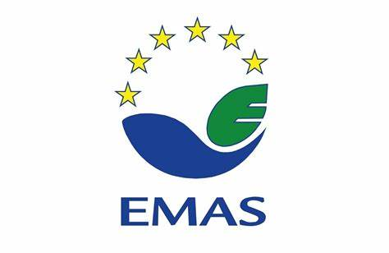
Example – Eco-Management and Audit Scheme (EMAS) 2/2
Potential Project Activities:
Expert advice: provision of advice to develop e.g., the environmental policies / environmental management systems. Evaluation, reporting and improvement of the organisation’s environmental performance. ​
Studies and assessments: Feasibility studies, analyses, impact assessments. Development of guidelines and educational material. ​
Capacity building, communication and awareness: Communication strategies, e-learning solutions, exchange of good practices, training the trainers, etc. ​
IT Capacity building: Expertise advise in IT infrastructure (e.g., environmental data collection).

