Slide 1
Interoperability for proactive public services
Enhancing public administration productivity through data exchange and citizen-centric services.
15 May 2024
Directorate General for Structural Reform Support (DG REFORM)

Slide 2
Goals
Why are we even talking about this?
What exactly are proactive services, and why should public administrations strive for that?
It’s everywhere these days, but what is interoperability?
Barriers and (potential) solutions
Next steps!
Notes:
Last year’s eGovernment benchmark found that around 7% of services are proactive across the EU
Malta is leading the pack with 18%

Slide 3
Why is this relevant?
Notes:
- MT leader in the EU with 18% of services being provided proactively

Slide 4
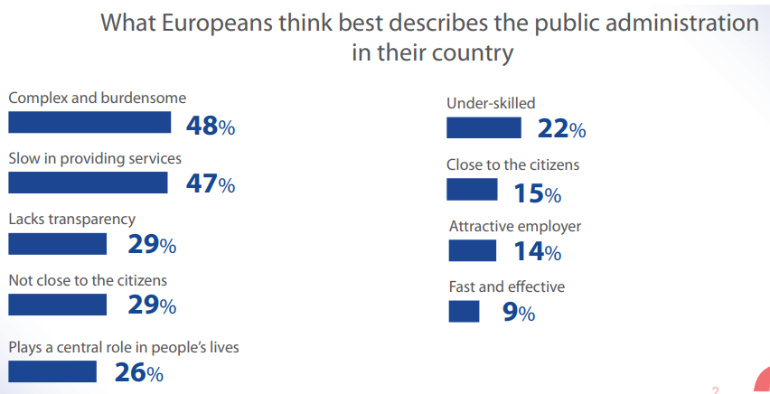
Citizens expect more from their public administration
Notes:
- 2023 DG REFORM Eurobarometer

Slide 5
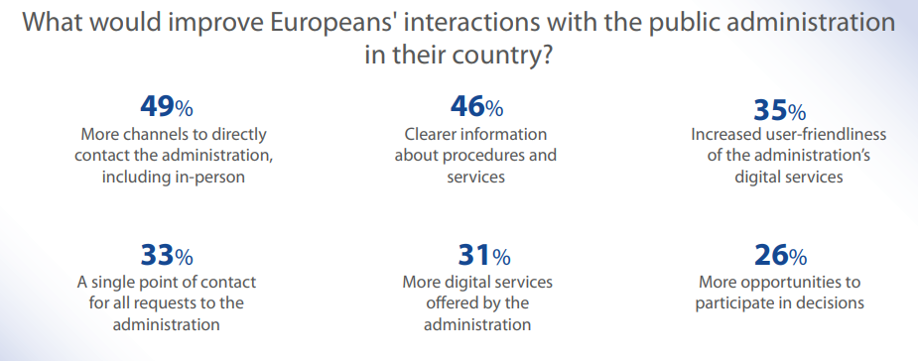
Difficulties to access services and find relevant information is likely to erode trust in public administration
Notes:
- Clearly difficult for citizens to navigate the administration in their MS
- Citizens don’t get the information they need or don’t understand it
-

Slide 6
Why is this relevant?
Citizens’ needs and expectations
Barriers to the access of public services and information can erode trust in PA and institutions

Slide 7
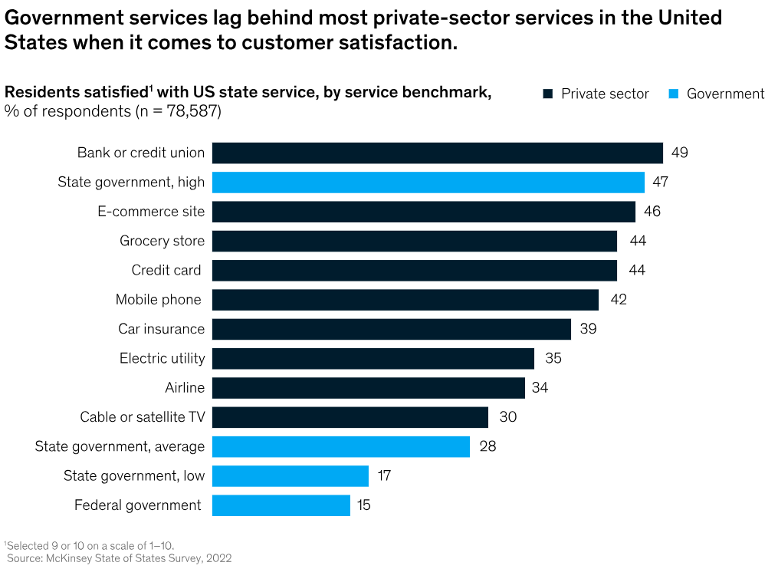
Citizens have more and more examples of how it can work
Notes:
- This is a bit of a different story, and I won’t delve into it here too much, but these results also make a clear case for public-private partnerships

Slide 8
Why is this relevant?
Citizens’ needs and expectations
Barriers to the access of public services and information can erode trust in PA and institutions
Closing the experience gap between private and public services
→ There is a need to rethink the current way most services are offered and the relationship between users and government. This means change our processes and systems, and train our workforce to enable this transformation
Notes:
- Not only digital transformation but more of a paradigm change

Slide 9
What are proactive services?

Slide 10
Defining proactive public services
“Proactive service delivery means that no action is required from the citizen to obtain the service. By connecting data sources in the back end, governments know automatically which services citizens are entitled to.”
“Proactive public services (PPS) use existing data on individuals and businesses to help decide if they are eligible for a service and to trigger provision.”
Notes:
- Discuss later HOW proactive one wants (and should) be, probably varies per service
Egov benchmark definition
Tony Blair institute definition
https://www.institute.global/insights/public-services/what-are-proactive-public-services-and-why-do-we-need-them

Slide 11
A few examples of PPS
Netherlands
Automatically obtain child allowances after registering a new-born child
Luxemburg
Proactively receive unemployment benefits after registering as unemployed
Malta
Automatically receive a state pension when reaching the retirement age
Notes:
- Examples taken from the eGovernment benchmark 2023 report
- These represent two different types of services, action-triggered and event triggered

Slide 12
Benefits of proactive services
Service user
Personalised and reliable services: Tailored offerings through complete data integration
Administration
Streamlined operations: Fewer redundancies and repetitions
Reduced bureaucracy: Fewer repetitive information requests
Faster service delivery: Quicker responses through enhanced data flows (e.g. between services)
Increased transparency: Greater visibility into processes
Enhanced access to services: Broader and more inclusive reach
Data-Driven decision making: Optimised decisions from integrated data
Cost efficiency: Lowered administrative costs
Proactive problem solving: Early identification and resolution of issues
Improved policy development: Enhanced insights for targeted policies
Notes:
- Reliable and way less error-prone both on the side of the service user an administration
- Savings and better outcome, really!?
- First order benefits, not second order and indirect such as increased trust in public administration and institutions
- Much broader appeal. Nice to have for me but can be life changing for users with disabilities or special needs

Slide 13
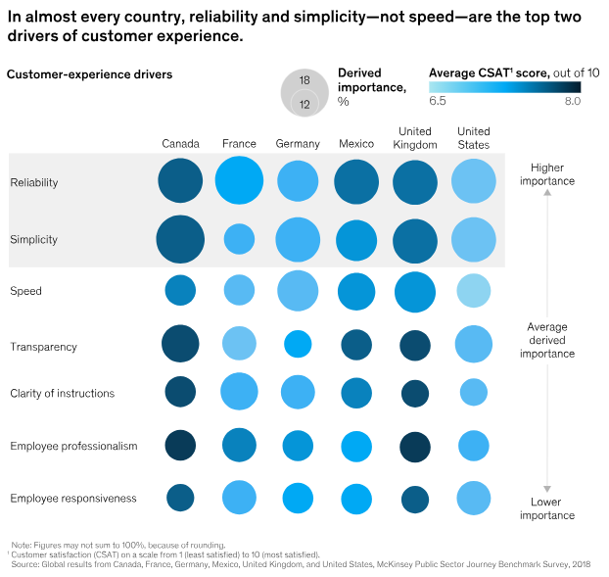
Could this be what users want?
Notes:
- Derived importance shows that reliability and simplicity are key expectations, even more than speed.
- Proactive services can deliver on that, but we can see that the entire process doesn’t have to be entirely proactive since speed isn’t the largest factor

Slide 14
What is interoperability?
What does it mean for proactive services, and what are usual barriers?

Slide 15
Defining interoperability
“the ability of Union entities and public sector bodies of Member States to interact with each other across borders by sharing data, information and knowledge through digital processes in line with the legal, organisational, semantic and technical requirements related to such cross-border interaction”
Notes:
- Definition from the Interoperable Europe Act.
- The words in white (invisible) are “cross-border” because it is not relevant here although it is a key aspect of the Act

Slide 16
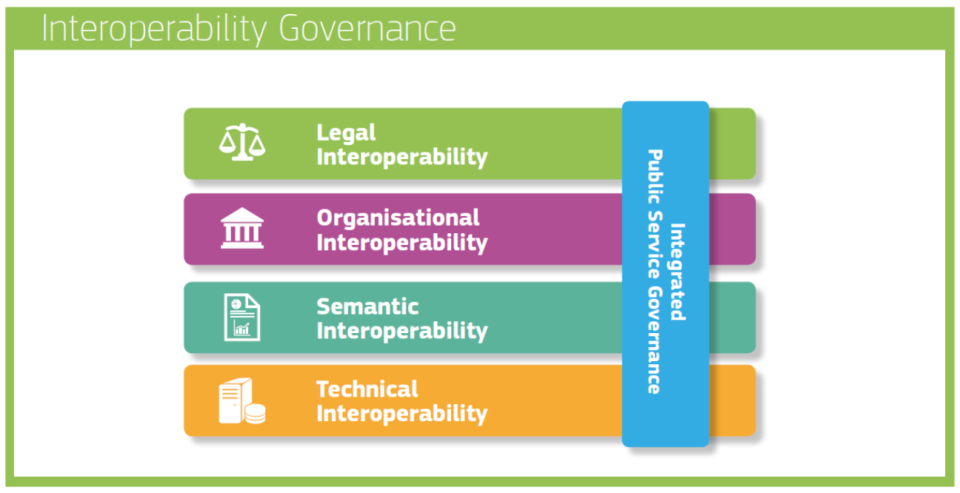
Navigating the Layers of Interoperability
Notes:
Diagram stolen from DIGIT
1. Legal Interoperability
making sure that all technology used follows the law, so everything can work smoothly together without legal problems.
2. Organisational Interoperability
helps different organizations work together effectively, ensuring they share information easily and understand each other’s roles.
3. Semantic Interoperability
makes sure that when information is shared, everyone understands it in the same way. It’s like speaking the same language.
4. Technical Interoperability
getting different technologies and computer systems to connect and communicate properly so they can work together without issues.
5. Public Service Governance
oversees how public services are provided, making sure they are easy for everyone to access and use, combining all the above efforts into a smooth service.
6. Integrated Governance
brings together all different aspects of governance to ensure that every part of the public service system works together perfectly as a whole.

Slide 17
What does it mean for proactive services?
Unified (or inter-connected) registries (all citizen data in one place)
Real-time data
Whole-of-government collaboration
Resource optimisation
Proactive problem solving
Notes:
- Unified registries: A single system for public records; updated across all platforms in real time improves consistency and reliability
- Real-time data: Real-time data exchange between services and systems
- Whole-of-gov collaboration: Facilitates collaboration between different services, especially when working on the same service/life event
- Resource optimisation: Federated data systems reduce redundancy and ensure that resources are allocated efficiently across government
- Proactive problem solving: Providers can proactively address issues before they escalate by leveraging predictive analytics and shared data insights

Slide 18
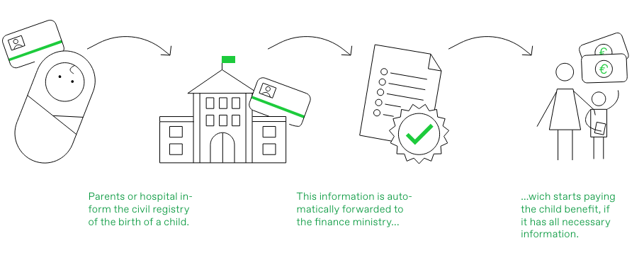
Quick example from Austria
Notes:
- Using this one because when it was introduced back in 2015 it was one of the first proactive services implemented
- The administration are doing two things here:
1. The information was already there, so they reused data instead of asking new parents who have something else in mind
2. Data minimisation: Only the required amount of data is at every point, so the hospital shouldn’t have access to people’s tax data

Slide 19
Usual barriers to interoperability
Silos
Data privacy
Decentralised policy / service responsibilities
Complex system integration
Legal traditions
Digitisation of archives
Budgetary restrictions but also financial disincentives
Incompatible ICT systems
Notes:
- Data privacy: Regulations can limit data sharing, especially for sensitive or personal information
- Lack of collaboration: Little to no collaboration between different services in charge of providing services belonging to the same life event
- Complex system integration: Integrating complex systems with different operational parameters can be lengthy and difficult
- Budgetary restrictions: The development and maintenance of interoperable systems, especially in the long-term, might be a restriction
- Incompatible ICT systems: Diverse (legacy) ICT infrastructures hinder seamless data sharing (differing data formats, standards, protocols, etc.). E.g. orga, legal, and semantics with data catalogues, common sets vocabularies, metadata

Slide 20
Next steps

Slide 21
Next steps
Adopt a whole-of-gov approach – What is the user experience? Start thinking of life events instead of specific services.
Simplify requirements but also internal processes – what is really essential to keep? What are the organisational consequences?
Identify legal and organisational bottlenecks to data exchange. Personal data can be exchanged securely (e. g. checking criteria instead of information access)
Work on building blocks, e.g. identification (identity wallet), interoperability layer
Notes:
- Need for an overhaul of the way public administrations think about service provision

