Slide 1
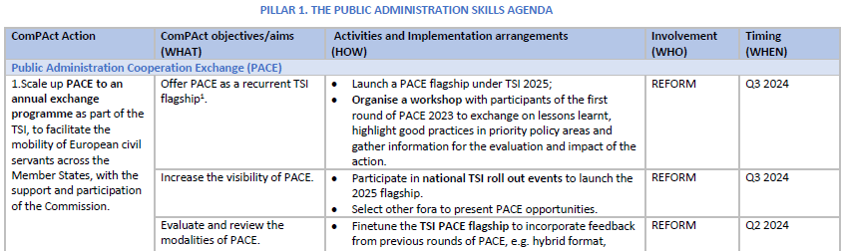
ComPAct Implementation plan - Purpose
Emphasises the voluntary basis of Member States participation
Demonstrates links between Pillars and with TSI 2025 flagships
Indicates timeline and stakeholder involvement, including existing networks in the digital area

Slide 2
ComPAct Implementation plan - Measures
Key features of Implementation plan
58 ComPAct activities will be launched in 2024.
31 activities are directly related to ongoing TSI projects (individual or multi-country) and forthcoming TSI flagships.
The Public Administration and Governance Expert group will be directly involved in 9 activities, such as the Passport of core competences, the Network of centre of excellence; the EU leadership programme, etc.
DG REFORM will implement 26 activities alone.
It will collaborate with other DGs in 26 activities.
Other DGs will implement 23 activities alone.
Timeline
2024
58 ComPAct activities
27 ComPAct activities
2025-26

