Slide 1
ComPAct - Pillar I - Skills for public administration systems
Objective
Support public administrations in Member States at the national, regional, and local level in their efforts to build resilient, attractive, transparent, and high performing public administrations that design and deliver quality policies and services.
Specific focus on better systems and capacity for EU policy/law implementation.
Flagship outcomes will help build citizen and business trust and reduce administrative burden.
The flagship will support developing system capabilities, skills for the future, and modern human resources management, in line with the Public Administration Skills Agenda of the ComPAct.
Notes:
Public administrations across the EU need to ensure the necessary skills, competences, and capabilities on the individual, organisational and system level to address complex challenges, and to deliver quality policies and services. Critical challenges include implementing EU policies/legislation and reducing administrative burden. Public administrations often struggle to attract and retain qualified staff due to increasing competition for talent in an aging society, and the image of the civil service. Only 14% of EU citizens see their administration as an attractive employer, almost half see public administration as ‘complicated and burdensome’ and ‘slow in providing services’. Outdated selection approaches and lengthy recruitment processes discourage well-educated potential recruits. Mobility across the civil service and between tiers of government tends to be limited. While upskilling and re-skilling of existing staff could compensate for a lack of new recruits to some degree, many administrations fail to reach the EU 2030 headline target of having at least 60% of all adults in training every year. To ensure system capacity and professionalism, public administrations need to anticipate the long-term development of their workforce. Public administrations need to find the best way to ensure performance in such a context.

Slide 2
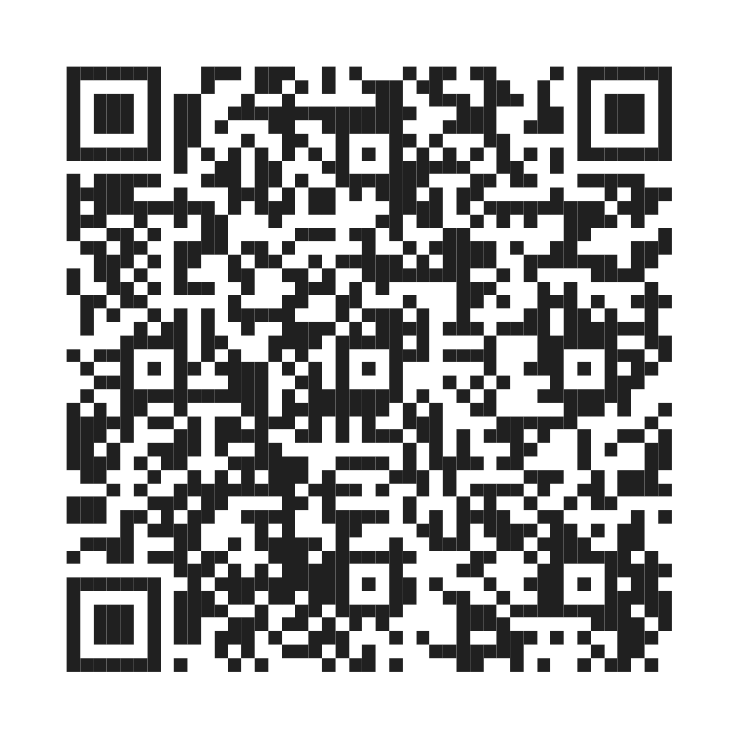
The below is an indicative, non-exhaustive list of support measures:
Indicative support measures
Developing tools, systems and capacity for organisational development, knowledge and change management.
Competence and skills audits across current job profiles.
Design and implement reforms to increase attractiveness, retain talent and increase the mobility, learning and career development opportunities in the public administration.
Introduce cross-cutting competency frameworks, e.g. for procurement, policy making, management of EU programmes, etc.), mapping of training needs, appraisal and promotion – at all levels of government.
Identification of learning needs based on the skills required for the future, including addressing the digital and green transitions, building trust and reducing administrative burden.
Develop tools and methods for continuous learning, communities of practice, training curricula and capacity, including approaches for evaluation of training quality.
Developing current human resources management practice, including through strategic workforce planning, staff surveys, tools and methodologies for data analytics, capacity for branding, communication, etc.
Notes:
Developing tools, systems and capacity for organisational development, knowledge and change management, to help build a well-functioning and joined up government.
Competencies and skills audits across current job profiles; including for example leadership, analytical, problem solving, collaboration, digital, service, technical and personal skills.
Design and implement reforms to increase attractiveness, retain talent and increase the mobility, learning and career development opportunities in the public administration.
Introduce cross-cutting competency frameworks (particularly for senior managers and on leadership development), thematic competency frameworks (e.g. for procurement, policy making, management of EU programmes, etc.), promoting their use for mapping of training needs, appraisal and promotion both horizontally (among national administration) and vertically (between national and local administration);
Identification of learning needs based on the skills required for the future, including addressing the digital and green transitions, building trust and reducing administrative burden.
Develop tools and methods for continuous learning, communities of practice, training curricula and capacity, including approaches for evaluation of training quality.
Developing current human resources management practice, including through strategic workforce planning, staff surveys, tools and methodologies for data analytics, skills anticipation, workforce data, capacity for branding, communication, etc.

Slide 3
Example - strategic workforce planning
Why (problem breadth/depth/urgency)
Aging of civil service, competition for talent, new skills needed, new career development paths (engagement)
What (objectives)
Develop comprehensive perspective on workforce planning, supporting civil service strategy and effectively expenditure management
Develop / test data-based people management
How?
Lessons learned
Existing frameworks are of limited applicability: very context-specific; jobs vs skills
Most common difficulty is data availability, quality, and access (GDPR)
Very complex stakeholder environment (internally & externally)
Sustainability requires concrete provisions for use and development beyond project lifecycle
Huge potential for EU exchange & communities of practice

Slide 5
Example - strategic workforce planning (SWP)
01 – Analyse workforce (data collection and analysis; civil service and labour market)
06 – Monitor and evaluate
(process, methods, tools)
02 - Forecast needs (forecasting models, vision about future structure, processes and services)
01
02
05 – Implement strategies (ensure organisation and resources, capacity of HR and management)
06
03
05
03 - Analyse gaps (methods and tools for analysis)
04
Activities
Depending on overall HR strategy, data maturity, HR and organisational development practice will cover one or more stages of the SWP
May also (or only) focus on the enablers for SWP (data and HR management)
May cover the whole system or be a pilot
Community of practice and next steps essential
04 – Develop strategies (co-design options with internal and external stakeholders)

