Slide 1
Success factors for delivering services to citizens
EU Expert Group – May 2024

Slide 2
This morning:
The (importance of) designing user centric services;
The (importance of) short-term outcomes;
How can DG Reform and Expert Group help?
An Roinn Caiteachais Phoiblí agus Athchóirithe | Department of Public Expenditure, NDP Delivery and Reform

Slide 3
Designing user centric services - The (importance of) the Life Events Approach
An Roinn Caiteachais Phoiblí agus Athchóirithe | Department of Public Expenditure, NDP Delivery and Reform

Slide 4
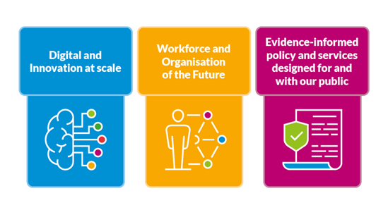
Better Public Services – Ireland’s Transformation Framework
Inclusive, high quality and integrated Public Service provision that meets the needs and improves the lives of the people of Ireland.

Slide 5
Better Public Services – Ireland’s Transformation Framework
Digital and Innovation at Scale
The Public Service will work together to
Public Service Bodies will identify and prioritise actions to
Tackle big societal issues and drive societal change
Achieve a seamless user experience and inclusive service delivery
Provide a dynamic and agile workplace
Deliver digitally enabled services and functions
Support digital inclusion
Provide joined-up services using MyGovID
Develop scalable innovations and create dynamic workplaces
A Public Service that:
Builds trust in public institutions | Focuses on outcomes | Delivers climate action and sustainability
Notes:
Talking points -
Why DSP are here, Birth Certificate
Rationale behind Life Events
Where DPER are with Life Events programme
Working together to co-create Birth Certificate project
DSP’s view on Life Events; timing, scope/scale and challenges
Need for initial identification of Birth LE stakeholders

Slide 6
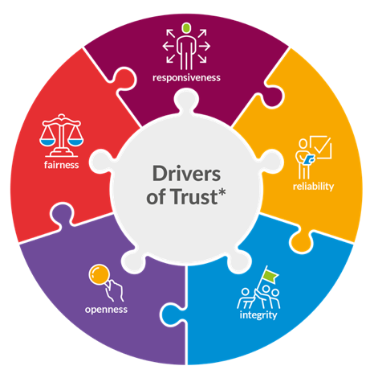
Trusted Services are easy, safe and quick to use
Personalised
Easy/Intuitive to Use
Empathetic
Trusted & Secure
(Once only)
An Roinn Caiteachais Phoiblí agus Athchóirithe | Department of Public Expenditure, NDP Delivery and Reform
OECD Trust Survey 2021 & 2023 (under embargo)

Slide 7
Enabling the Digital Transformation of Governments (OECD)
The digital innovation space
A place of opportunity or discomfort?
An Roinn Caiteachais Phoiblí agus Athchóirithe | Department of Public Expenditure, NDP Delivery and Reform
Notes:
Ireland has placed in the top 10 international performers in the 2023 Digital Government Index (DGI) published by the OECD. Ireland is ranked alongside countries such as Korea, Denmark, the United Kingdom, Norway, and Canada. The Digital Government Index is a report that assesses the efforts made by governments to establish the foundations necessary for a digital transformation of the public sector that is coherent and human-centred.
The DGI assesses countries’ digital government by looking at the degree to which they have the necessary foundations in place to be able to leverage data and technology to deliver a whole-of-government and human-centric digital transformation of the public sector.
In this year’s index, the OECD commended Ireland for demonstrating a comprehensive approach to ensuring strong foundations for digital government with a balanced performance across the six dimensions they examined.

Slide 8
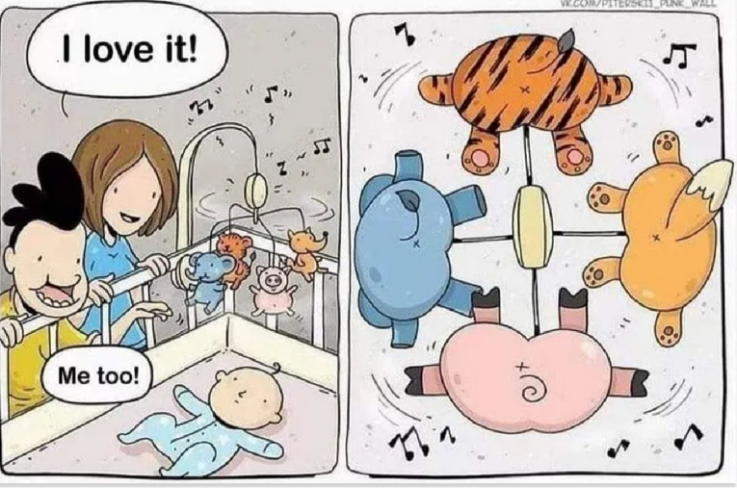
Why user design matters?
Even with policy-makers’ good intention….
An Roinn Caiteachais Phoiblí agus Athchóirithe | Department of Public Expenditure, NDP Delivery and Reform

Slide 9
Why user design matters?
….perspective….
An Roinn Caiteachais Phoiblí agus Athchóirithe | Department of Public Expenditure, NDP Delivery and Reform
Notes:
If not convince of the importance of perspective try to google giraffe painting a lion!

Slide 10
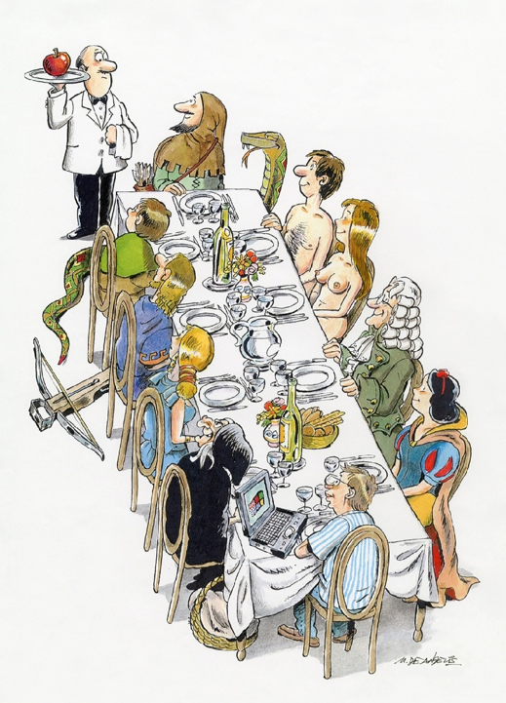
Why user design matters?
..and meaning differs
An Roinn Caiteachais Phoiblí agus Athchóirithe | Department of Public Expenditure, NDP Delivery and Reform

Slide 11
10 Design Principles for Government
in Ireland
We will put
people first
We will design services together
We will design so knowledge can be reused
& shared
Principle 01/
Principle 03/
Principle 05/
We will design
to be inclusive
We will design for trust
Principle 02/
Principle 04/
We will challenge assumptions
& design
with evidence
We will design to deliver value - in all its forms
We will work
to make
things simpler
Principle 06/
Principle 08/
Principle 10/
We will design from the top down & the bottom up
We will build, test, learn & iterate
Principle 07/
Principle 09/

Slide 12
Our Vision for Design in the Public Sector
Our vision is to position Ireland as a global exemplar of design-led public service transformation.
We are committed to infusing design principles into every aspect of public services, enhancing well-being, and optimising government efficiency. Through insight-driven decision-making, experimentation, and co-creation, we aim to drive the delivery of better public services, all while working to improve living standards for the people of Ireland.

Slide 13
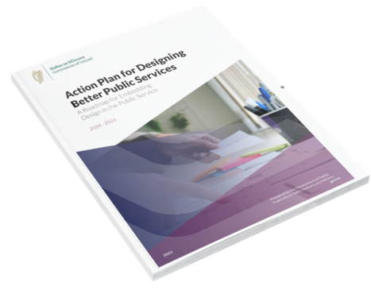
Action Plan for Designing Better Public Services
Encouraging Design Integration
Establishing Design Funding
Leveraging Design Expertise
Demonstrate Design
Commitment
Increase Design
Capability
Foster a Design
Culture
Developing Design Resources
Enhancing Design Skills
Stimulating Collaborative Design Experiences
Promoting Design Successes
Facilitating Design Challenges
Fostering a Design Community

Slide 14
Life Events
Life events refer to significant experiences or changes in an individual's life that can have a profound impact on their circumstances and/or well-being. These events often necessitate interactions with multiple services or agencies
Renting, Buying,
Moving House
Having a baby &
early childhood
Owning &
Driving a Car
Setting up a
Business
Finding &
losing a job
Moving to
Ireland
Marriage/
Divorce
End
of life

Slide 15
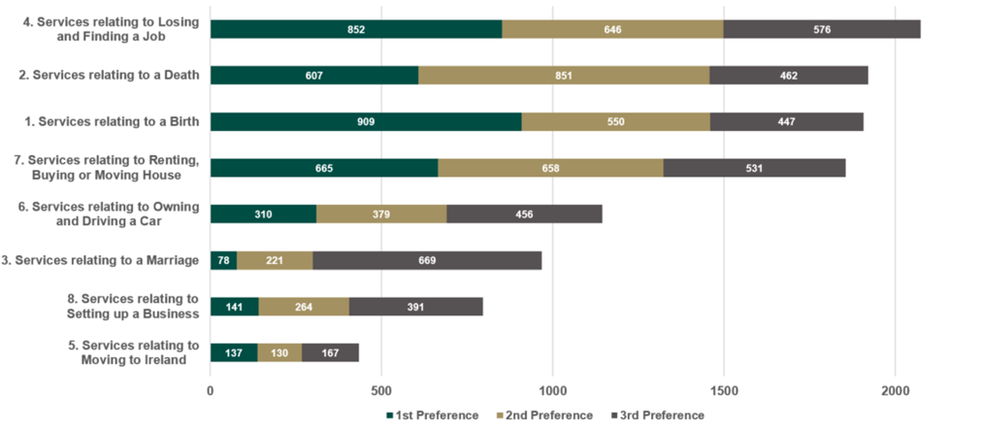
Public Consultation

Slide 16
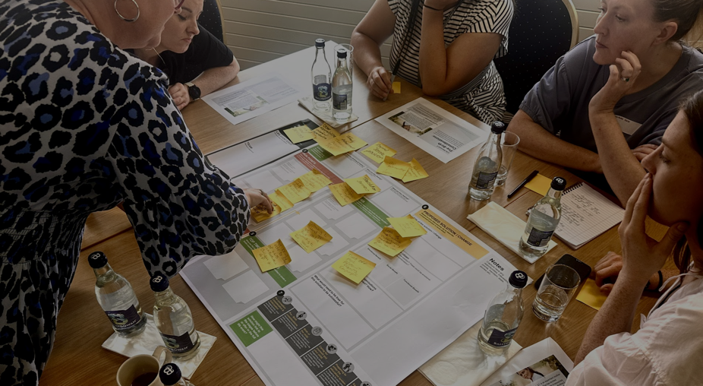
Design Principles in action
Dept. Health
New Parent
HSE
OCGIO
Obstetrician
Dept of Children
DSP

Slide 17
Proactive Services
A Life Events Approach
The Citizen at the centre
Stability through consistency
Trust through transparency.
Empowerment through information
Comfort in privacy
Reliability through support
Delight in experience
Digital
Wallet
Life Event
Portal
Digital Wallet
Secure Data Handling
Minimal Disclosure
Seamless Integration
Trusted Authentication
Accountable Transparency
Departments
a
b
c
d
e
f
g
h
i
j
k
k
Life Event Portal
User-Centred
Tell Us Once
Proactive Services
Integrated Service Delivery
Accessible & Inclusive
Agencies
Private / Community
Technical Building Blocks

Slide 18
BIRTH LIFE-EVENT PHASES
Pre-conception
Consideration & Anticipation
Pre - Birth considerations
Birth of the child
The first days and weeks
of the baby's life including making the child a citizen and securing supports
Preparing body, mind and life situation to welcome a baby
Developing knowledge, skills and preparing to welcome child into the home
Preparing to enter the education system
Caring for yourself and your child
Preparing for your child to
enter education and providing supports to give them the best possible start
Supporting you and your child to give best possible opportunity for a happy and healthy future
Early school years and Returning to work*
Preparing for the next phase of child rearing and beginning to think about what's next for you

Slide 19
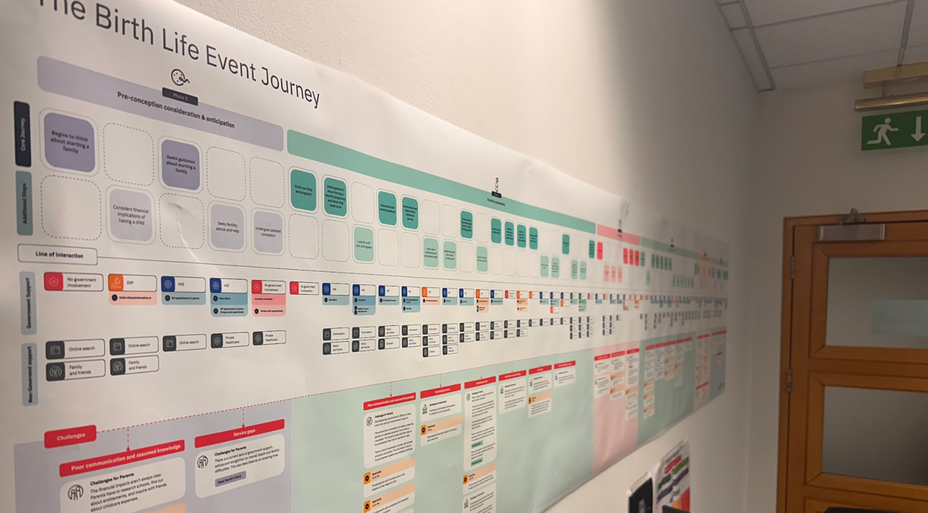
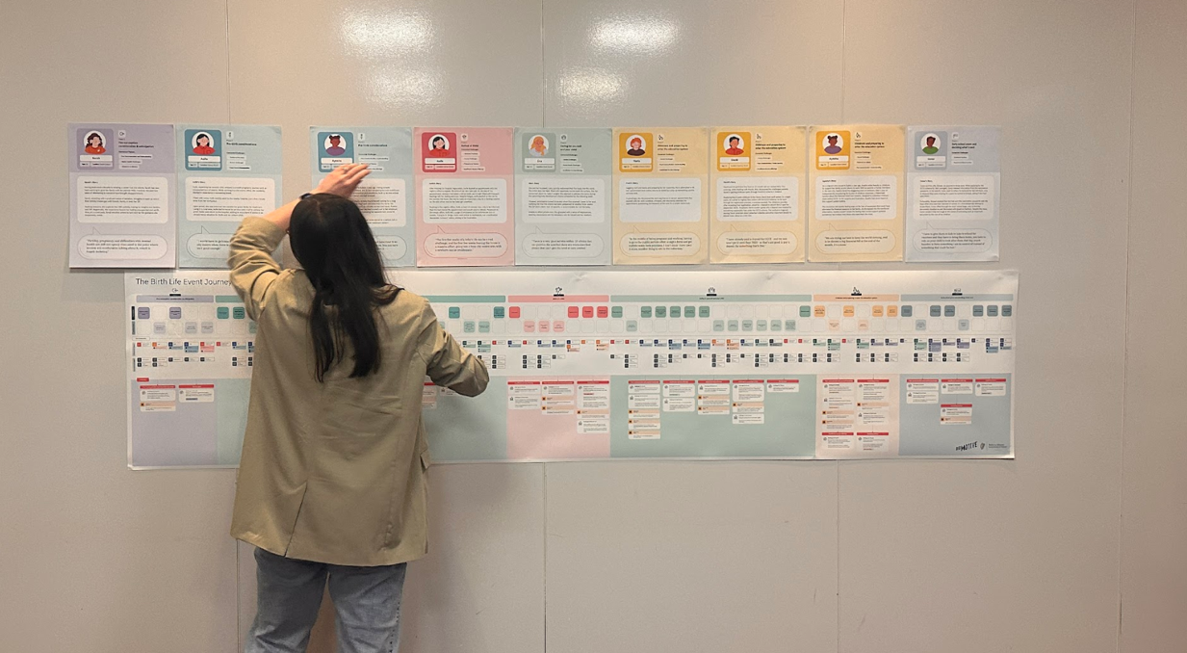
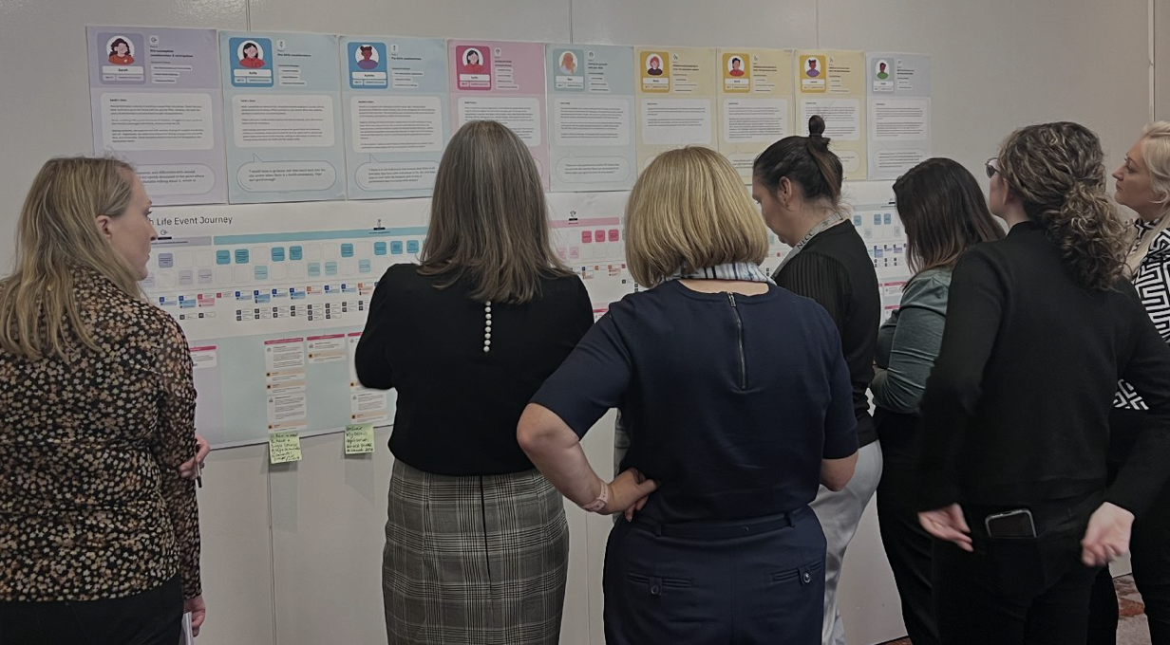
Mapping the birth life event

Slide 20
The (importance of) short-term outcomes

Slide 21
Our (2030) Strategic Transformation Programme
Culture Change (Life Events)
Quick
Wins (Wallet & credentials)
EU Regulatory Adherence (SDG, eIDAS)

Slide 22
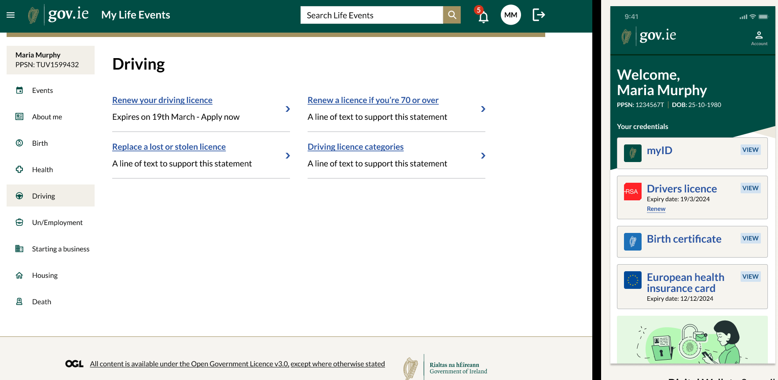
MyGovID

Slide 23
Life Events & Digital Wallet Development
Life Events
Digital Wallet App
Verifier App
Information Mediator

Slide 24
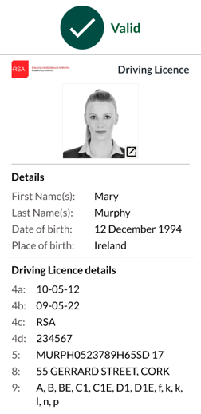
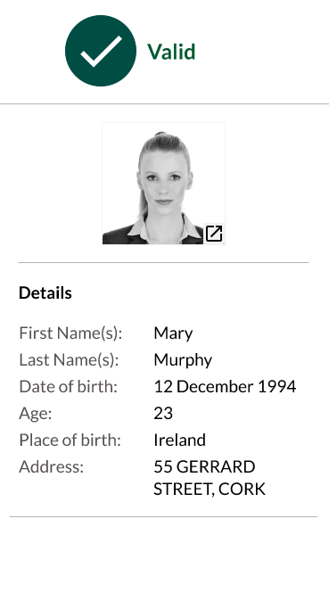
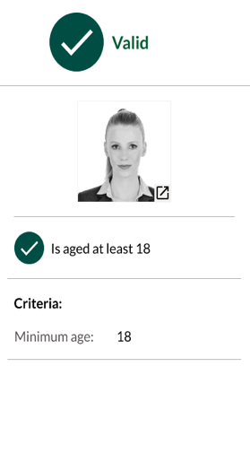
Data & Selective Disclosure

Slide 25
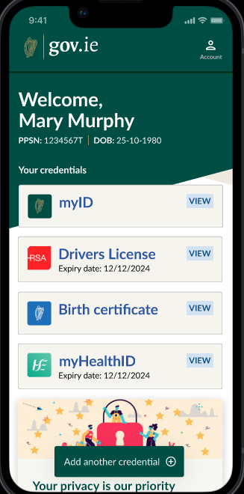
Digital Wallet June Pilot: Scope
Launch to approx. 1000 public service pilot participants
Key credentials can be accessed and stored in this wallet
Participants will log in to a gov.ie app using their MyGovID
A MyGovID credential will be created and stored in the wallet
As well as Digital Driving Licence, Birth Cert and EHIC
This pilot will run for 5 months – June to October
Base functionality will be improved & enhanced thereafter
GDW launch will extend to wider public later in 2024
A Validator app will be developed to confirm validity of valid credentials but NOT deployed in the Stage 2 pilot
EHIC

Slide 26
DG Reform & Expert Group

Slide 27
ComPact – Shared principles of quality public administration
Strategic vision and leadership that ensures capability, resilience and sustained public trust.
Coherent, anticipatory, evidence-informed, participatory, digital-ready, and inclusive policy making
An impartial, professional, merit-based, collaborative, and effective civil service, performing in good working conditions.
High-quality, innovative, human-centric, and accessible public services.
Subsidiarity, coordination, accountability, openness of public administration, integrity, and oversight of administrative processes.
Sound and sustainable public finances, underpinned by integrated and comprehensive accruals-based public accounting systems.
Notes:
Compact – Digital Pillar -·emphasis on interopability & once only
DG reform & expert group - opportunity to embded the user-centricity at EU level through EU digital wallet/eIdas and share good practice in terms of navigating GDPR

Slide 28
How can DG Reform & Expert Group help?
Ireland is not unique in its efforts to provide integrated public services
EU government wallet regs & interoperability focus = enabler
User centricity & subsidiarity (especially re SDG implementation)= important
Expertise from other countries re driving digital transformation and compliance to EU digital regs and GDPR requirements – including through TSI projects
Digital reform underpinning wider public service transformation

Slide 29
Thank You

