Slide 1
Ministry of the Interior and Kingdom Relations

Slide 2
Introduction and Agenda
Introduction and Agenda
How it started
Our process
Learning experience
Next step
Maria Møller Kursch, International Coordinator Agency for Public Finance and Management, markur@oes.dk
Dutch-Danish PACE project – Green Governance
How it started
Our process
Learning experience
Next step
Introduction
Agenda

Slide 3
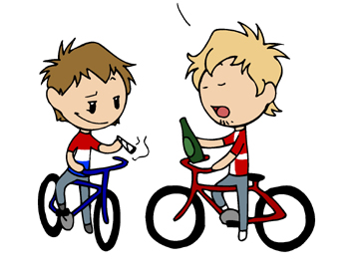
Netherlands and Denmark have many shared interests and challenges
Introduction and Agenda
How it started
Our process
Learning experience
Next step

Slide 4
What are the outcomes of a succesful collaboration?
Introduction and Agenda
How it started
Our process
Learning experience
Next step
Forming long term networks for future knowledge exchange
Expand understanding of partner country’s system
Deepen understanding of own system
Other outcomes
Finding and exchanging transferable solutions
Finding different levels of maturity and adapting solutions
Finding shared challenges and brainstorming solutions

Slide 5
Opening the green black box
Introduction and Agenda
How it started
Our process
Learning experience
Next step
How are our countries organised?
Who should we involve?
Which agendas do we share?
What is green governance?!?!
Knowledge gaps

Slide 6
Organizational differences to overcome
Introduction and Agenda
How it started
Our process
Learning experience
Next step
Ministry
Agency
Procurement
Policy
Executive
Carbon Footprint
Wide scope
Narrow scope
Digital and datadriven
External consultancy
In house

Slide 7
Project Timeline
Introduction and Agenda
How it started
Our process
Learning experience
Next step
desk research and settling topics
Global workshop and final report
Initial planning
April-May 2023
June 2023
July-August 2023
September 23 – January 24
February – March 24
High level kick-off
Physical exchanges on working level
Online kick off and research

Slide 8
Examples of activities during exchanges
Introduction and Agenda
How it started
Our process
Learning experience
Next step
Site visits
Workshops
Brainstorms

Slide 9
Paving the way for a successful green collaboration
Introduction and Agenda
How it started
Our process
Learning experience
Next step
Make time for understanding your mutual systems
Don’t be afraid to involve people outside your organization
Make an active programme
Put practitioners in the room together – that’s where the magic happens
Learning experience:

Slide 10
24-26 january: Next exchange in The Hague
March: global workshop in Copenhagen

