Slide 1
Evidence-informed change management: examples from on-going TSI projects
Mina Shoylekova,
DG REFORM

Slide 2
Measuring Citizen’s Satisfaction with Key Government Services for Better Performance and Enhanced Trust (23HR01)

Slide 3
Project outline
Objective: improve services by creating tools and capacity for service quality management
Common measurement framework
Recommendations for better service quality management and creating a user-centric environment
Link with the Single Digital Gateway; life events, understanding quality of different channels
Timeline: September 2023 – August 2025
Austria, Croatia, Estonia, Finland, Greece, Ireland, Latvia, Lithuania, Slovenia, and Spain

Slide 4
Notes:
- Perhaps specify here that

Slide 6
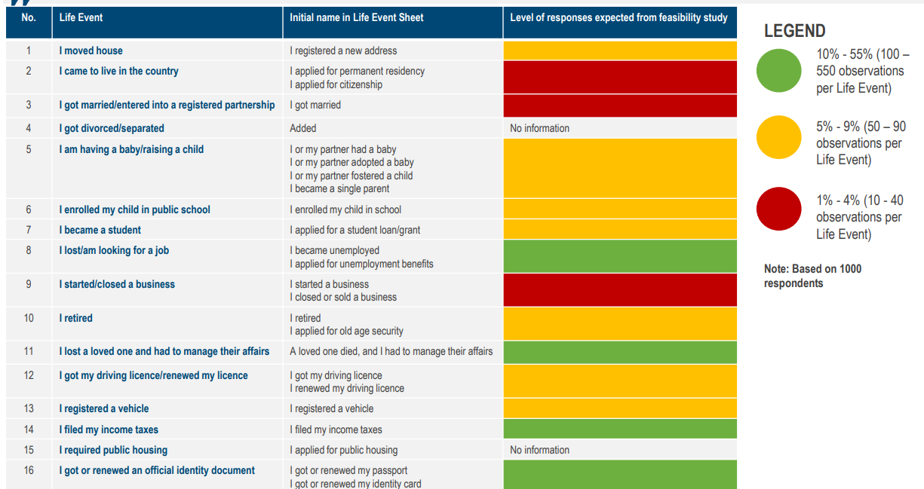

Slide 7
EU Survey of central government public servants: strengthening evidence-based people management policies and reforms (23LU02)

Slide 8
Project outline
Objective: to strengthen the use of evidence for people management based on international good practices.
Develop a standard EU Survey of Central Government Public Servants
Recommend good practices and support the design of new HR policies
Timeline: September 2023 - June 2025
Belgium, Bulgaria, Croatia, Latvia, Lithuania, Luxembourg, the Netherlands, Slovakia, and Slovenia

Slide 9
Added value of an EU Survey
International comparisons help understand the national context
Cross country data will allow comparisons for different policy areas, enabling policy learning
Same definitions for metrics
Experience and capacities to discuss results
Civil service polices based on data – stronger organisational development

Slide 10
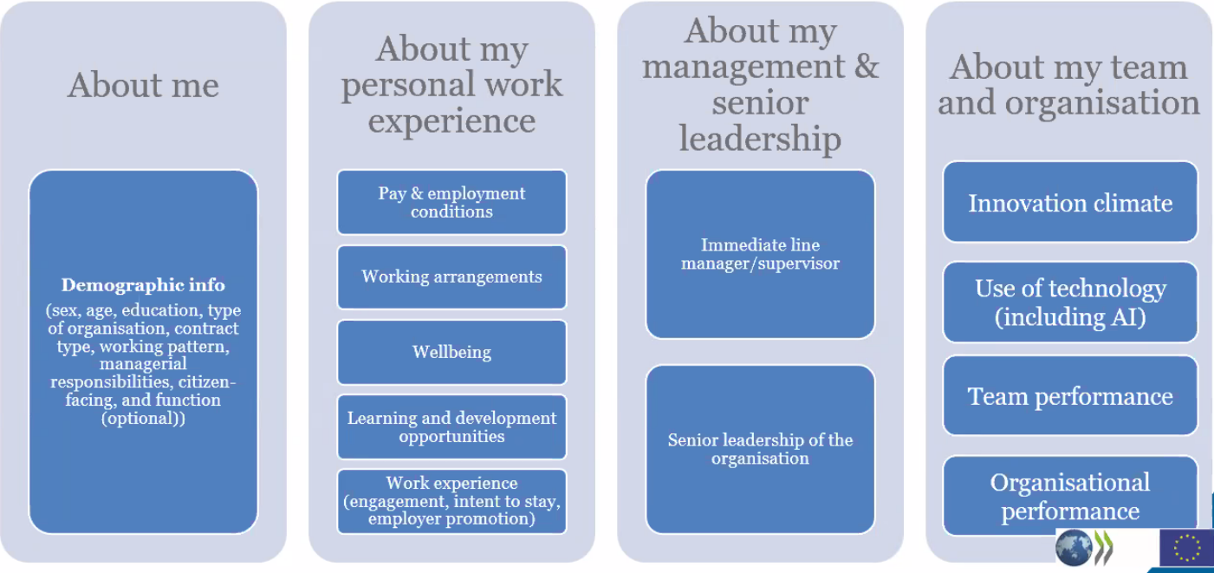

Slide 11
Towards a Common Framework for Comparative Public Employment Data

Slide 12
Project outline
Objective:
small set of agreed, comparable HRM indicators and methods
Piloting and data collection
Better understanding of people analytics activities, challenges and how to better contribute to people management policies
Volunteers: Australia, Brazil, Belgium, Canada, Chile, France, Greece, Ireland, Latvia, Norway, Portugal, Spain, Türkiye, the United States
Observers: Sweden
Timeline: December 2022 – December 2024

Slide 13
Steps
REVIEW OF METHODOLOGIES
SHORT-LIST - “IMMEDIATE” AND “FUTURE” INDICATORS
REVIEW OF INTERNATIONAL INDICATORS AND IDENTIFICATION OF OPTIONS FOR FURTHER DEVELOPMENT
CLARIFY METHODS FOR ORGANIZATIONAL VS COUNTRY DATA
FINALISE FOR BROADER ROLL-OUT
PILOT IN SMALL SAMPLE

Slide 14
