Slide 1
Implementing ComPAct – actions under Pillar II
Andrea Halmos (Moderator)
Deputy Head of Unit DIGIT B2
Interoperability and Digital Government

Slide 2
Digital decade policy, a driver for Pillar II
Targets related to digital public services
Digital Decade 2030 targets
100%
Key public services online
By 2030, MS will have to provide online 100% of the key public services to their citizens and businesses
Four cardinal points guide the Digital decade policy targets for 2030:
Skills (targets related to ICT specialists and basic digital skills)
Digital transformation of businesses (targets related to tech up-take, innovators and late adopters)
Secure and sustainable digital infrastructures (targets related to connectivity, data and cloud)
Digital transformation of public services
100%
Access to medical records
By 2030, 100% of citizens have access to their medical records online
100%
EU citizens with eID
By 2030, 100 % of EU citizens will have access to a digital ID

Slide 3
Implementing ComPAct: 5 digital actions under Pillar II
01
Implementing digital and data-related legislation, including AI
02
Sustainable and effective use of emerging technologies
03
Fully accessible online administrative services
Support public administrations with implementing data-related legislation and increasing readiness to integrate AI into their operations.
Further develop open standards and support cross-border public services using decentralized technologies (i.e blockchain).
Further promote and facilitate the cross-border electronic exchange of information between public administrations:
Once-Only Technical System
Internal Market Information System
European Exchange of Social Security Information
04
Increased interoperability& seamless public services
05
Federation of cloud capabilities across public administrations
Interoperable Europe Support Centre to assist public administrations with interoperability assessments and implementation of the EIF.
Procurement of an open-source SMART middleware platform to enhance delivery of public services and providing guidance on the procurement of cloud services.
Extra
Publish an overview of the funding opportunities for public administrations’ digital transformation and the synergies between them

Slide 4
Implementing digital and data-related legislation, including AI
1

Slide 5
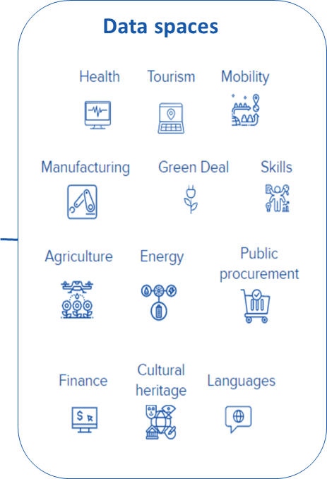
EU data strategy
The European data strategy aims to make the EU a leader in a data-driven society. Creating a single market for data will allow it to flow freely within the EU and across sectors for the benefit of businesses, researchers and public administrations.
Data spaces
Data Governance Act
Promote the re-use of sensitive data held by public sector bodies
Open Data Directive – High Value Datasets
Data Act
Improved public service delivery, in particular regarding effective and rapid response to public emergencies
Data produced by the public sector that is particularly interesting for value-added services .
Support
Data Spaces | Joinup (europa.eu)

Slide 6
Data Governance Act
Leveraging the potential of data for the economy and society
Promote the re-use of sensitive data held by public sector bodies
Framework for new data intermediaries in the Single Market
Corporate and Individual data altruism for purposes of general interest
Co-ordination and interoperability: European Data Innovation Board
Horizontal framework for the creation of a single market for data

Slide 7
What is the Data Act going to change?
Harmonized rules on data access to unlock the potential of the
EU’s industrial data, enabling innovative and competitive market participation
Empower individuals and companies using connected products and related services to control how the data they co-generate is used
Improved public service delivery, in particular regarding effective and rapid response to public emergencies
Facilitate switching for cloud users in the EU between different providers of data processing services
More transparency and control over data will lead to broader and better-informed decisions
Better and more efficient public services and policies
Modern, seamless, multi-vendor, interoperable and federated cloud/edge services market
New data-based business opportunities for small and large firms alike

Slide 10
AI Act: Risk-based approach
Unacceptable risk
e.g. social scoring, untargeted scraping
Prohibited
High risk e.g. recruitment, medical devices
Permitted subject to compliance with AI requirements and ex-ante conformity assessment
*Not mutually exclusive
‘Transparency’ risk
‘Impersonation’ (chatbots), deep fakes
Permitted but subject to information/transparency obligations
Minimal or no risk
Permitted with no restrictions, voluntary codes of conduct possible

Slide 11
Prohibitions – political agreement
Social Scoring
Individual predictive policing
Assessing or predicting the risks of a natural person to commit criminal offence
for everybody, public and private
Biometric categorisation
of natural persons based on certain biometric data
except filtering datasets based on biometric data in the area of law enforcement
Emotion recognition
in the workplace and education institutions
unless it is for medical or safety reasons
Except in relation to specific crimes under narrowly defined circumstances, prior authorisation by a judicial or independent administrative authority.
Untargeted scraping
Of internet or CCTV for facial images to build-up or expand databases
Real-time remote biometric identification

Slide 12
High-risk use cases as defined in Annex III – political agreement
Biometric recognition systems
Safety components for critical digital infrastructures, road traffic and the supply of water, gas, heating and electricity
Education and vocational trainings, e.g. to evaluate learning outcomes and steer the learning process and monitoring of cheating
Employment, workers management and access to self-employment, e.g. to place targeted job advertisements, to analyse and filter job applications, and to evaluate candidates
Access to essential private and public services and benefits (e.g., healthcare), creditworthiness evaluation of natural persons, and risk assessment and pricing in relation to life and health insurance

Slide 13
Enforcement of the AI Act – political agreement
European Artificial Intelligence Board
High-level representatives of competent national supervisory authorities
Advising and assisting the Commission (including the AI Office)
National
competent authorities
Supervises high-risk conformity
Market surveillance for Annex II, EDPS for union entities
Advisory forum
Balanced selection of stakeholders, including industry, start-ups, SMEs, civil society and academia
to conduct evaluations, request measures and issue fines
Commission’s internal implementation body
Supervises general purpose AI
AI Office
Scientific Panel
supports the implementation and enforcement of the Regulation as regards GPAI models

Slide 14
Fundamental rights impact assessment - political agreement
Targeted at high-risk AI systems
To be carried out by...
Deployers that are bodies governed by public law or private operators providing public services
Operators providing high-risk systems
Consisting of a description of...
Deployers processes, in which the high-risk AI system is intended to be used
Categories of natural persons and groups likely to be affected by its use in the specific context
Specific risks of harm likely to impact the affected categories of persons or group of persons
The implementation of human oversight measures
measures to be taken in case of materialization of the risks

Slide 15
Sustainable and effective use of emerging technologies
2

Slide 16
Emerging technologies
Emerging technologies
Increase discoverability and visibility
The Public Sector Tech Watch hosts emerging tech. use cases of public administrations. Public administrations have the chance to share their use cases online.
Data and emerging technologies (e.g., AI. Blockchain) are enablers for better digital public services. A data-driven public sector transforms the design, delivery and monitoring of public policies
Piloting GovTech solutions
GovTech ecosystem
The GovTech Incubator brings together public administrations for piloting and scaling up ICT solutions focusing on emerging tech.
Public Sector Tech Watch
Observatory on the use of emerging technologies in public sector
Set up a GovTech community
GovTech Incubator
GovTech Connect
GovTech Connect brings together GovTech actors for seizing opportunities, mitigate risks and share experiences
Testing arena for public administrations to experiment, test and pilot GovTech solutions
A community for GovTech actors to seize opportunities and share experiences
Related studies
Use of AI by the public sector, Adoption of AI by the public sector, AI for the public sector, AI for interoperability

Slide 17
Fully accessible online administrative services
3

Slide 18
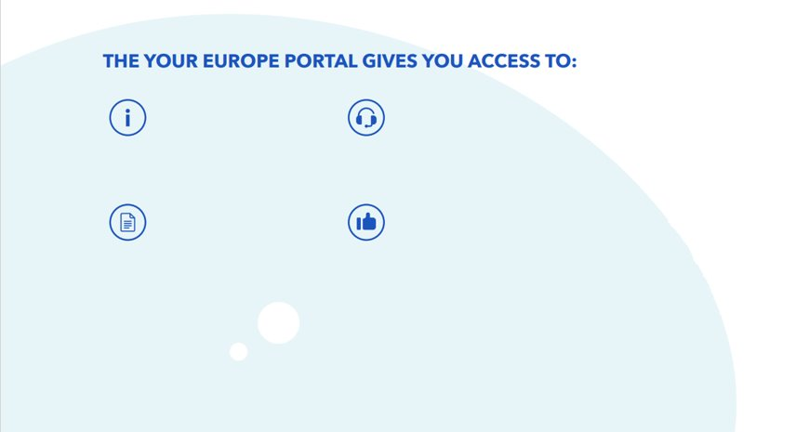
The Single Digital Gateway Regulation
Information
About rights and opportunities in the single market
At EU, national and local level
Assistance
Gateway to advice and problem-solving services
E-Government Procedures
Fully digitalised 'once only' procedures in key areas
By end of 2023
Policy feedback
Reporting on obstacles
Powered by the Once-Only Technical System

Slide 19
The Single Digital Gateway is currently in full deployment
Single Digital Gateway Regulation
Entry into force
Go live of
Online information (Annex I) - Central
Government level
Common IT Tools
Search facility
Assistance service finder
Feedback Tool
Assistance
Single Market Obstacles Tools
Deadline
for local authorities: online information (Annex I)
Go live of
Launch of the Once-only Technical System
Connection of MS competent authorities to OOTS
Key procedures fully online for national and cross-border users (Annex II)

Slide 20
Automated evidence exchange via the Once-Only Technical System
Evidence needed to complete administrative procedures online
Exchanged at the request of the user
In December 2023:
The Once Only Technical System (OOTS) for this exchange was established (deployed by the Commission & Member States)
Member States shall ensure a smooth onboarding to enable the connection between the procedure portals and the OOTS
Over the year 2024 more than 80 000 national authorities must sign up to the OOTS, to enable an automated exchange of evidence

Slide 21
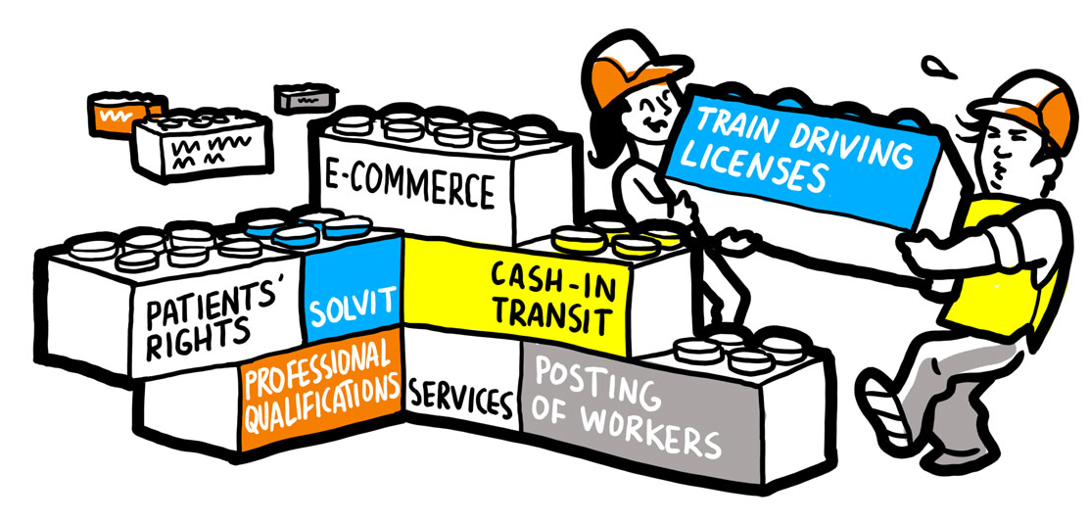
Internal Market Information System (IMI)
Implementation and enforcement of Single Market legislation
Flexible and adaptable
Structured pre-defined set of questions & Multilingual
Data protection – Privacy by design
Trust
Single Market
Flexible
Flexible
Structured
Data Protection
Structured
Data Protection
Structured
Generic online application for administrative cooperation between the EU/EEA public authorities

Slide 22
IMI – 15 years of connecting authorities across borders and languages
20 policy areas
35,000+ registered users
97 procedures
12,000+ authorities
9 DGs
GROW, EMPL, ECFIN, CNECT, SANTE,
HOME, MOVE, JUST, EDPS
585,000+ exchanges
33 million posting declarations
2 Public interfaces
European Professional Card
Road Transport Posting Declarations

Slide 23
Communication on digitalisation in social security coordination
Facilitating free movement in the Single Market
Taking stock of existing initiatives
Proposing short- and long-term objectives towards more digitally integrated and interoperable social security systems

Slide 24
EESSI - IT system helping social security institutions exchange information across Europe
G
G
to
Government-to-Government
The Commission will "work with Member States to accelerate their implementation efforts (full deployment end 2024) and provide quarterly monitoring and reporting of these efforts."
More than 75 Mil. Messages since start in 2019
Connecting around 3400 institutions in 32 participating countries
97% of BUCs deployed. 15 countries fully ready to exchange.
Improvement of the operations through enhancement of system’s architecture and technical specifications.
Improvement on the business processes through the Business Process Improvement program.
Management of a users’ community.
Ensure the overall security, quality and monitoring of the system.
Develop and maintain central components, new releases of the common data model
Business, technical and operational support to the Member States.
Provide the secretariat of EESSI governance bodies (Administrative/ Technical Commission, Ad Hoc Groups)
Develop agreements ensuring regulatory compliance and improvement of the operations (Terms of Cooperations, data protection, services level agreements, etc…).

Slide 25
European Social Security Pass (ESPASS)
G
B
C
to
and
Government-to-Businesses and Citizens
A pilot project to digitally verify citizens’ social security entitlements across borders.
Pilot activities, under the Digital Europe Programme, by two consortia of MS institutions (DC4EU and Vector) to be finalised mid-2025.
Based on results, decision on the opportunity to deploy ESSPASS in all EU countries and whether this would require a legislative framework.
Discussions on a possible first step implementation of a digital EHIC, before implementing the longer-term solution, based on the results of the pilot activities.

Slide 26
Increased interoperability& seamless public services
4

Slide 27
Public sector interoperability
Interoperable Europe Act
Increased interoperability
A place for information ranging from interconnecting base registries to ensuring semantic interoperability of data.
Strengthened collaboration between MS and the Commission on public sector interoperability
Interoperable Europe Support Centre
Seamless public services
Guidance to conduct ex-ante interoperability assessments ensuring seamless digital cross-border public services.
IOP Academy
Interoperability-related trainings for public administrations
European Interoperability Framework (EIF)
SEMIC Support Centre
EIF Toolbox guides users to finding operational solutions to better implement EIF nationally and guidance on the monitoring mechanism NIFO.
Guidance for data specifications, toolkit for data extraction, transformation and loading & knowledge hub.

Slide 28
Federation of cloud capabilities across public administrations
5

Slide 29
SIMPLE – In short
Simpl is the open-source secure middleware that will support data access and interoperability among European data spaces other cloud-to-edge federations, in particular among public sector organisations.
Development contract up and running since 1 January 2024.
Launch of the open-source community: 14 March 2024
Proof of concept: Summer 2024
Minimum viable platform: November 2024
Simpl-Open
Simpl-Labs
Simpl-Live

Slide 30
Interoperability at the core of the architecture
Smart Communities
Industrial data space
Simpl Agent
Simpl Agent
Simpl Agent
…
France
Compatible API
Destination Earth
Simpl Agent
Simpl Agent
Simpl Agent
Simpl Agent
Compatible API
Destination Earth middleware
Compatible API
Compatible API
HPC
Brussels
Andalucia
Simulations
Cloud nodes
Machine
learning
Earth
observations
Copernicus

Slide 31
Simpl conceptual architecture (1/5)
Four architectural layers describe the capabilities of Simpl
Administration services
Data services
Governance
Federation management
Application sharing
Data sharing
Support
Contracts
Application discovery
Data discovery
CSIRT
Security
Distributed execution
Data governance
Data orchestration
Data processing
Access control & Trust
Audit
Infrastructure connector services
Reporting
Cloud & Edge computing
HPC
Monitoring
PaaS services
Distributed execution
Network
Infrastructure discovery
Infrastructure orchestration
Infrastructure providers (DC, public cloud, private cloud, etc.)
Legend:
User services
Supporting services
More details al Simpl website, The architecture vision;
Notes:
Data layer:
Provides the functionality to share data and applications between participants.
Infrastructure connector services:
Connects to internal infrastructure orchestration services (like Kubernetes) to allow other data space participants to utilize the infrastructure
Administration service:
Provide administrative services used by both data and infrastructure layer. It vertically spans the functionalities of data and infrastructure layers
Distinguishing between user and supporting services:
User: the services that are offered by the users of the SMP. Not all actors will need all user services
Supporting: Support user services, run in the background while using user services

Slide 32
SIMPL
= playground environment for Simpl-Open
+
Interoperability test for existing data spaces
Simpl-Open
= the open-source smart middleware itself
Simpl-Labs
= instances of Simpl-Open for sectoral data spaces
Secondary eHealth Data Space
Simpl-Live
Public Procurement Data Space
Destination Earth
Language Data Space
Smart Communities

Slide 33
Cloud Public Procurement Guidance: Components
Public Procurement requirements:
Cloud first policy, multi-cloud strategies, corresponding institutional set-up.
Contractual aspects:
Fair contractual relations, protection against unfair contractual practices.
Commission
Recommendation
1
Data Protection:
Supporting complete compliance
with the GDPR by design.
Cybersecurity:
Adherence to appropriate
cybersecurity certification scheme(s).
2
3
Staff
Working Document
Staff
Working Document
Portability:
Effective service switching & data porting requirements.
Sustainability:
Supporting implementation of the
Green Public Procurement criteria.
4
5

Slide 34
Guidance: Forthcoming Commission Recommendation
Art. 1: Subject matter and scope
Art. 2: Cloud-first policy
Art. 3: Multi-cloud strategy
Art. 4: Licensing & Open-source practices
Art. 5: Procurement models
Art. 6: Adequate budgeting
Art. 7: Cloud Centre of Excellence
Art. 8: Steps to follow
Art. 9: Procurement strategy template
Art. 1
Art. 2
Art. 3
Art. 4
Art. 5
Art. 6
Art. 7
Art. 8
Art. 9

Slide 35
Discussion
What would you need most from the Commission to support you in the implementation digital and data-related legislation ?
Which opportunities and possible obstacles do you see for the delivery of fully accessible online administrative services by using the Single Digital Gateway?
Which opportunities do you see to combine the digital, the social and the green transition? Do you have examples of addressing this issue in your country?
In what way can the TSI better respond to national needs in relation to the action?
Priorities?

