Slide 1
Evidence-based practice in Policy
Prof Vincent Cassar
Prof Frank Bezzina
15th May 2024

Slide 2
How does ‘servizz.gov’ map itself as a good practice of evidence-based driven policy?

Slide 3
Complex decisions!
Simple decisions!
Trust me, 20 years of management experience

Slide 4
What is Evidence-Based Practice???
Evidence-based practice is about making decisions through the conscientious, explicit and judicious use of the best available evidence from multiple sources by
1. Asking: translating a practical issue or problem into an answerable question
2. Acquiring: systematically searching for and retrieving the evidence
3. Appraising: critically judging the trustworthiness and relevance of the evidence
4. Aggregating: weighing and pulling together the evidence
5. Applying: incorporating the evidence into the decision-making process
6. Assessing: evaluating the outcome of the decision take
to increase the likelihood of a favorable outcome.

Slide 5
1. Asking: Would increasing compulsory education decrease Early School Leaving?!
6. Assessing: How successful have these implementations been?
2. Acquiring: OK, what evidence should I look for? National stats, studies, ask experts, international fora, etc.
5. Applying: Given this wider and broader picture of understanding, what best recommendations can be placed forward?
3. Appraising: How much can I trust these evidence? NSO data (6/10); EU Reports (3/10); Research (7/10), etc.
4. Aggregating: OK, so what picture do I get after seeing all these evidence?

Slide 6
Evidence based decision making

Slide 8
EB Practice Framework

Slide 9
Bayes’ rule
posterior probability = prior probability x likelihood of the trustworthiness of the evidence:
Bayesian Decision Theory (i.e. the Bayesian Decision Rule) predicts the outcome not only based on previous observations, but also by taking into account the current situation.

Slide 10
A simple example of the trustworthiness of the evidence
Julia will cheat in the exam: TRUE vs FALSE (Prior Probability)
The initial probability that she will cheat = 10% = 0.1 P(H)
The initial probability that she will NOT cheat = 90% = 1 – 0.1 = 0.9 [P(not H)]
(A) What is the revised / posterior probability that Julia will actually cheat, given the evidence?
Therefore, P(H/E) = the probability that she will cheat, given the evidence we have now!
(B) What is the trustworthiness of the evidence, given that Julia will cheat?
P(E/H_{T}) = 0.3 (the likelihood of finding written notes in Julia’s handbag on entering the exam hall if she is willing to cheat)
P(E/H_{F}) = 0.2 (the likelihood of finding written notes in Julia’s handbag on entering the exam hall if she is not willing to cheat)
P(H/E) = P(H_{T}) x P(E/H_{T}) / P (E)
P(H_{T}) x P (E/H_{T}) = 0.1 x 0.3 = 0.03
P(E) = [P(H_{T}) x P (E/H_{T})] + [P(H_{F}) x P(E/H_{F})] = (0.3x0.1) + (0.2x0.9) = 0.21
Therefore P(H/E) = 0.03 / 0.21 = 14% is the posterior probability that Julia will cheat

Slide 11
Utilization of a minimum of 2 sources

Slide 12
Local example (1): The National Employment Policy 2021-2030

Slide 13
Source 1: The practitioners
Economists with specialization in labour economics
Data analysts from the National Statistics Office
Behavioural scientists
Public officers
Officials from the national employment agency (Jobs plus)
Research support officers
‘Challenge meetings’ to overcome conformity and confirmation biases

Slide 14
Source 2: The literature
Extensive desktop research on employment scenarios of all EU countries
Evaluation of documents from CEDEFOP, ILO, EU Commission, OECD
Comparative analysis with Malta
This generated a deep understanding of the main drivers of change:
Digitalization and automation
Global competition for talent
Enhanced quality of jobs
Sustainability and greening the economy
The rise of the platform economy
The future of work

Slide 15
Source 3: The organizational data

Slide 16
Source 4: The stakeholders
Focus groups with representatives of all the economic sectors (268 participants)
Questionnaires with industry leaders used later to conduct the econometric simulations (conducted by the Economic Policy Department)
Interviews with members of the Unions and Employers’ associations
Meetings with representatives of the MCESD
NSO survey of 4000 employees (sub-groups were constructed relative to sex, age group (16-34, 35-54, 55+) and economic activity based on NACE Rev. 2) (conducted by surveyors and data analysts at the NSO)
Focus group with representatives of the non-Maltese employee community in Malta

Slide 18
Local example (2):
Predicting emergency severity index and hospitalisation using data-driven machine learning analytics

Slide 19
Source 1: The literature
The Emergency Department (ED) is one of the most important components in a hospital ecosystem (Qureshi, 2010) and plays a vital role in saving people’s lives and reducing the rate of mortality and morbidity (Aringhieri et al., 2017).
It is a critical interface between the emergency medical services and the hospital (Christ et al., 2010) as most admissions originate from the ED.
Triage is a decision-making process that is applied to identify patients who require immediate attention and is guided by a classification model based on levels of prioritisation (Kuriyama et al., 2017).
The highly complex and dynamic ED environment functions under extreme constraints of time, physical space, high workload, and interruptions and distractions leading to extreme pressure (Smith and Dasan, 2018).
Improper triaging and prioritisation can lead to delayed care, inappropriate resource allocation, and fatal results (Fatovich et al., 2005).

Slide 20
Source 2: The stakeholders
The specific setting of this project is Mater Dei Hospital, a teaching hospital in Malta.
Serves a population of more than 460,000 people living on the island.
Covers an area of over 250,000 square meter and includes 1200 beds and 12 operating theatres.
Employs a workforce of 7,200 covering many occupations including medical personnel, i.e., doctors, surgeons, anesthetists, nurses, diagnostic and allied health professionals, administrative and clerical staff, engineers and technicians, amongst others.

Slide 21
Source 2: The stakeholders
From 2010 to 2022, the ED experienced year-on-year increases in patient numbers until April 2019 when COVID-19 pandemic hit Malta.
These increases were primarily driven by the growing population and the fact that the ED is increasingly being chosen as the primary route of access to the healthcare system (Azzopardi-Muscat et al., 2017).

Slide 22
Source 2: The stakeholders
Malta is experiencing consistent increases in the population due to an increased influx of tourists visiting the island and an increase in the number of foreign workers relocating to Malta.
Applying a conservative year-on-year increase of 5% in the ED visits, the ED could potentially experience an annual influx of over 172,000 patients by 2027.
This will result in an average of more than 472 patients per day (compared to current 380 patients per day), putting a tremendous strain on the capacity of the ED and significantly impacting the healthcare system.
The increase in demand is augmented by staff shortages.

Slide 23
Combining the 2 sources
THESE PROBLEMS INCLUDE
High patient volumes leading to over-crowding.
Continued increase in patient volumes due to population growth, aging populations, and the prevalence of chronic diseases.
Limited resources - challenges in meeting the demands of emergency care with the available resources.
Time-sensitive cases.
Delays (long waiting-times, delays in hospital admissions).
Over-triaging and under-triaging.
Lack of coordination with other departments.
Lack of up-to-date information.
Process bypass.
Emotional and psychological stress that can lead to medical errors.
Patient dissatisfaction.
These create an overall strain on the healthcare system

Slide 24
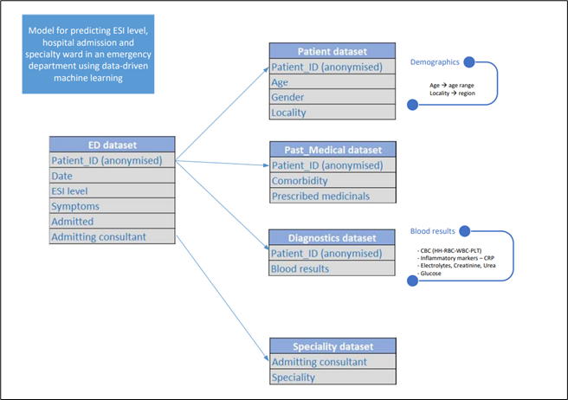
Utilising organizational data to address the lacunae from the first two sources by turning descriptive to predictive models
Data from Electronic Health Records (EHR), including past medical history, historical blood test results, and outpatient medications, as well as demographic details such as gender, age and region on 820,000 ED visits between 2017 and 2022.
Rule-based Machine Learning
Process
CDSS rules
PREDICTIONS
Based on optimal lilkeihood

Slide 25
Data-driven Clinical Decision Support System
1. ESI level
2. Probability of admission
3. Specialty admission ward
Patient visiting
Emergency Department
Triage Nurse
Patient data and parameters entered in CDSS
Patient Emergency Triage Predictions

Slide 26
The Framework
The Question
PICOC
The sources of the evidence
The trustworthiness of the evidence (Risk minimization and resource allocation maximization)
The aggregate effect of the evidence in favour of the question
The impact (ROI)

Slide 27
And therefore how does ‘servizz.gov’ map itself as a good practice of evidence-based driven policy?
The Literature
The Organizational data
The Practitioners
The Stakeholders

Slide 28
Thank you

