Slide 1

The Way to User-centric Services
(DG Reform Expert Group)
Massimo Vella
15/5/2024

Slide 2
1
5
Introduction
Digital Communication Channels
2
6
Freephone 153
Interaction with Stakeholders
3
7
Queue Management System
TSI (SRSP) - DigIT-X Project
4
Customer Relationship Management (CRM)
8
Way Forward

Slide 3
“Servizz.gov is the Government Agency that handles all Public Services, thus being the point of contact for citizens and their needs.
To increase service accessibility, servizz.gov is committed to providing services on various platforms and by every possible means, including in-person, over the phone, on social media and online.”

Slide 4
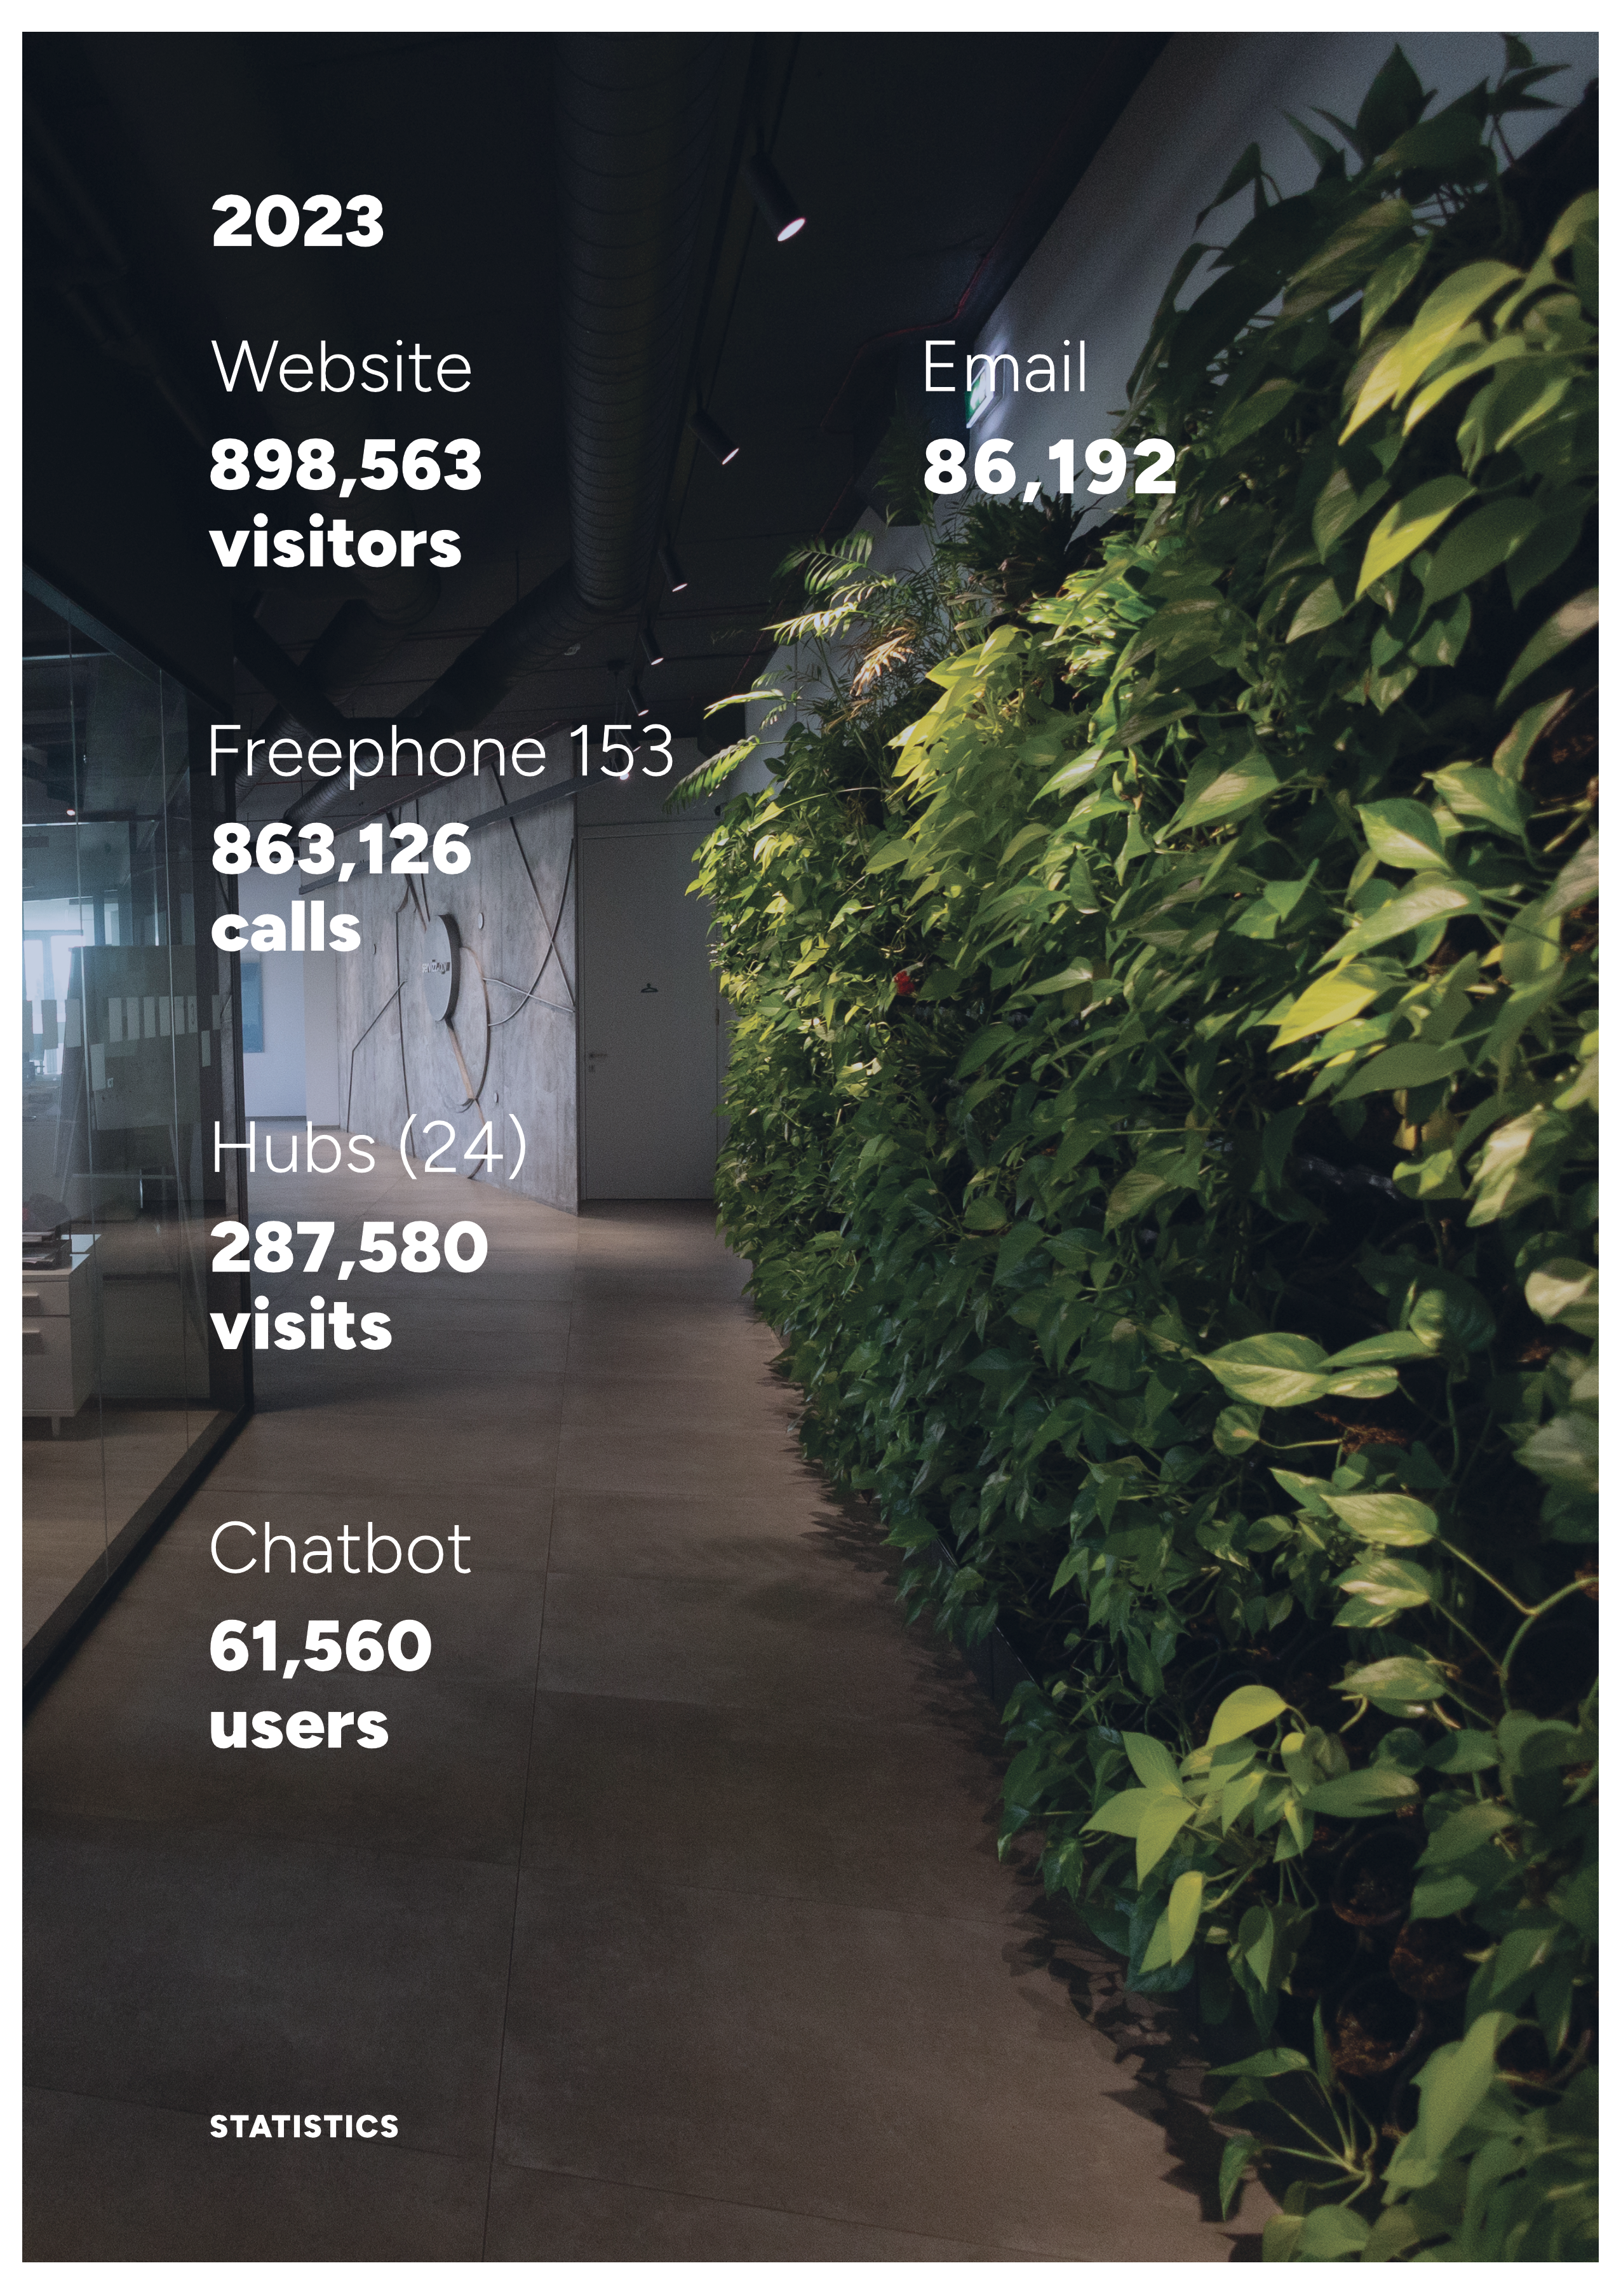
In 2015 three communication channels
Freephone 153 – approx. 24,000 calls
3 Regional Hubs
Website service catalogue early stage

Slide 5
Traditional Communication
Channels

Slide 6


Slide 7
Freephone 153 - Features
Monitor call volumes
    Calls received
    Calls answered
Metrics to measure performance
    Service Level Agreements
    Average Handling Time
    Average Waiting Time
    Abandoned Calls (Callbacks)
Forecasting models
    Historical Data
    Allocate adequate resources to handle call volumes
    Seasonal variations
    Call patterns

Slide 8
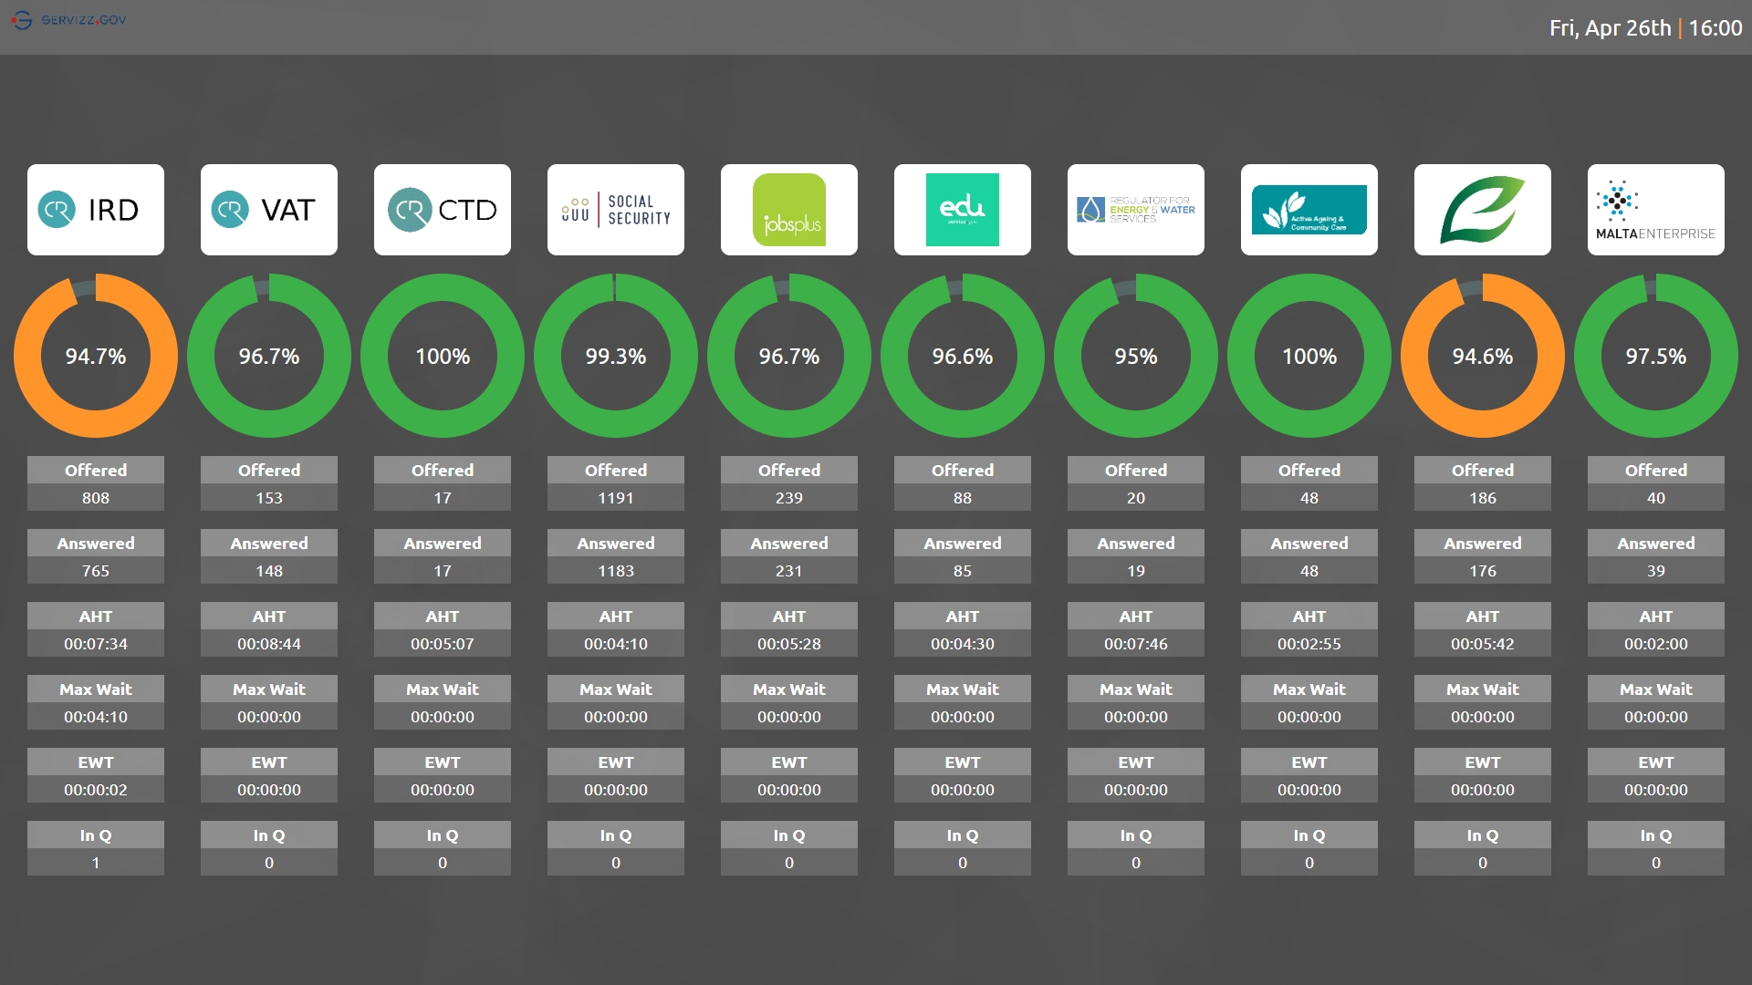

Slide 9
Queue Management System

Slide 10
Queue Management System - Features
24 Hubs
    22 Regional
    2 Technical
Helps the Agency to
allocate adequate
resources in real-time
Monitor demand to adjust
service provision hours
Monitor Customer Relationship Officers (CROs) productivity
Monitor:
    Average Waiting Time
    Average Handling Time
Appointment system
Feedback by customer (through SMS)

Slide 11
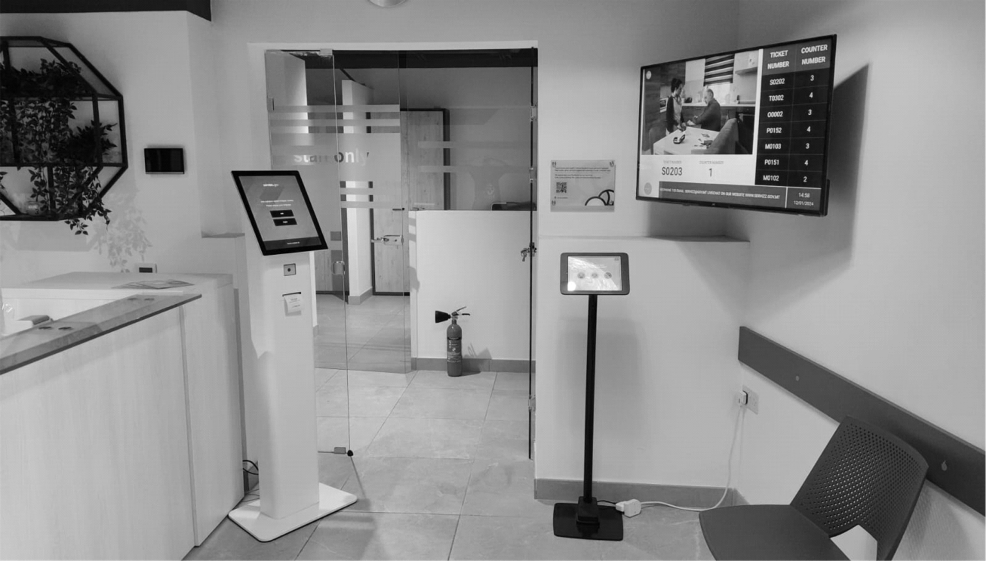






Slide 12
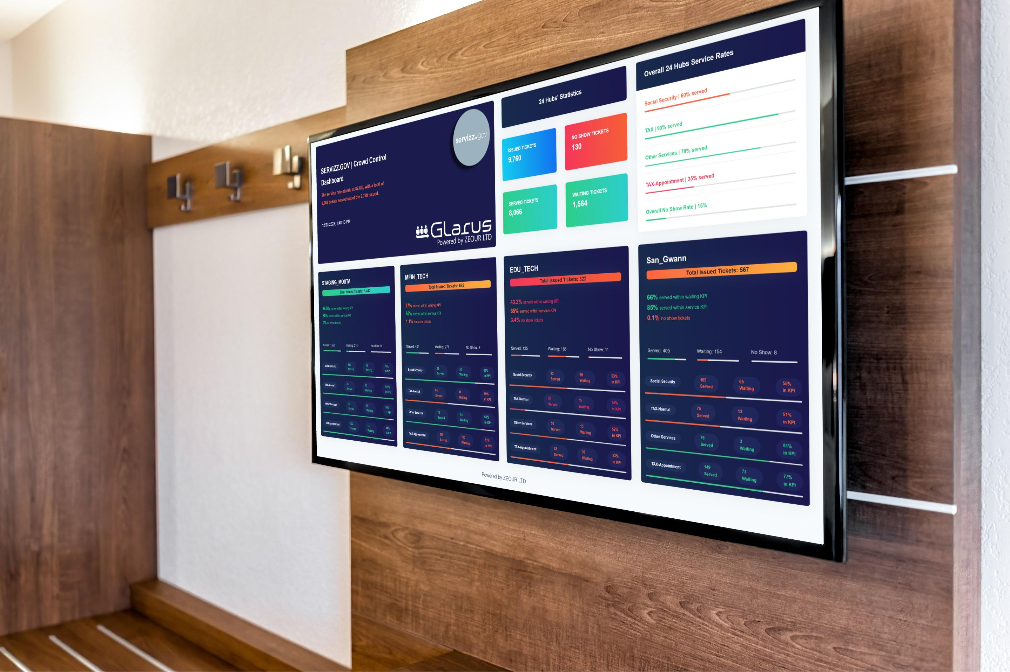
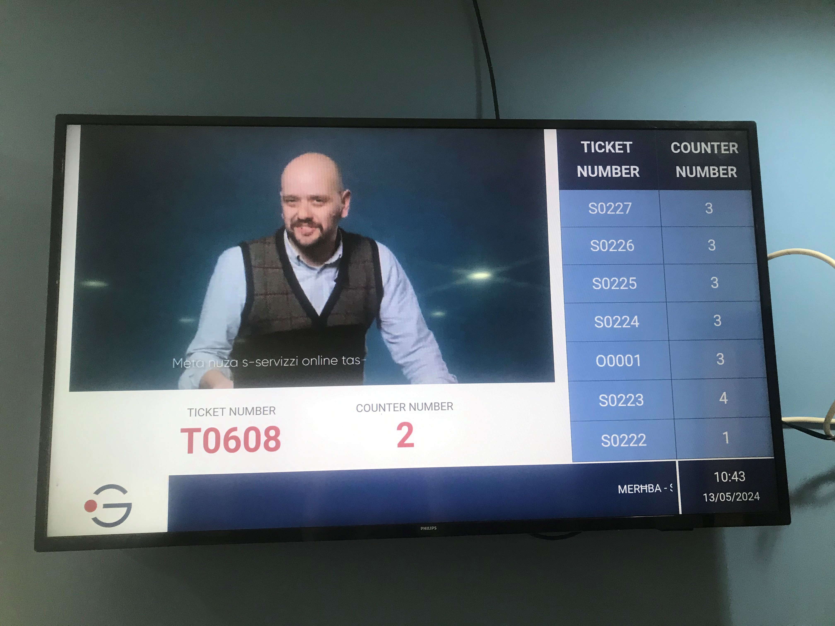
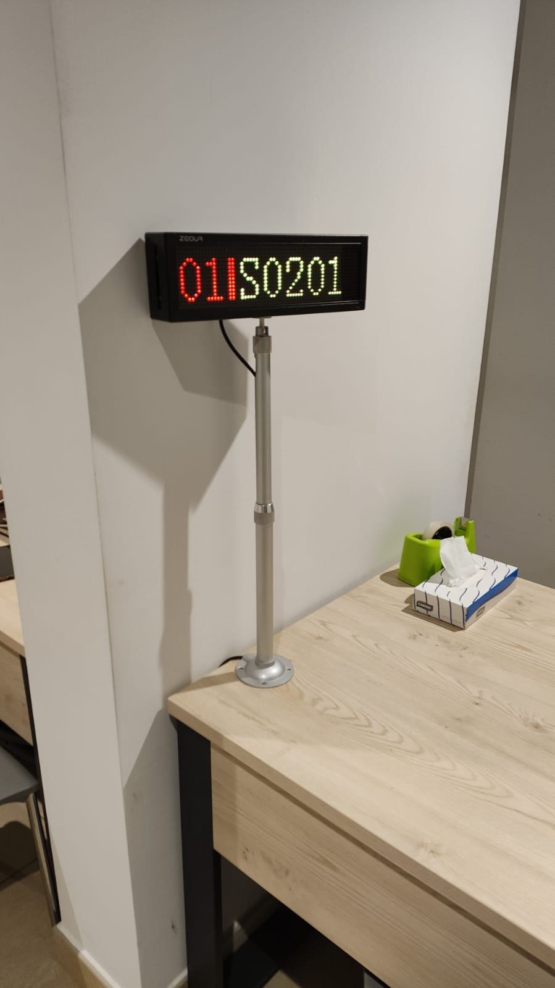
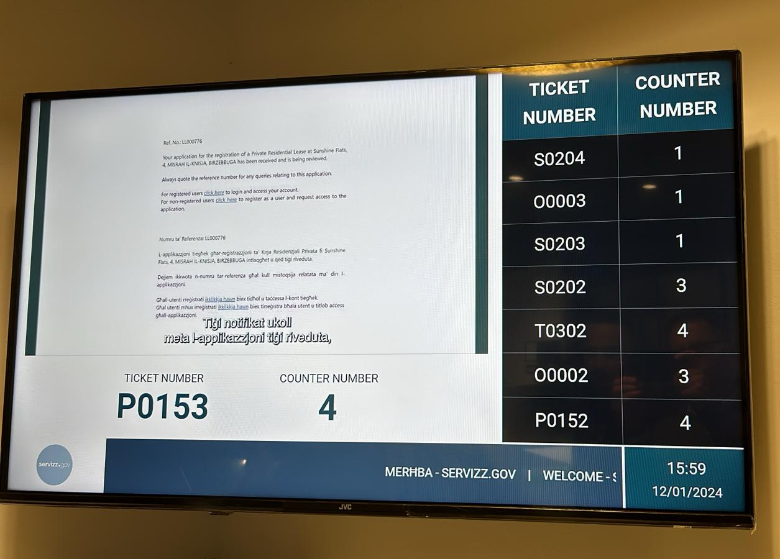

Slide 13
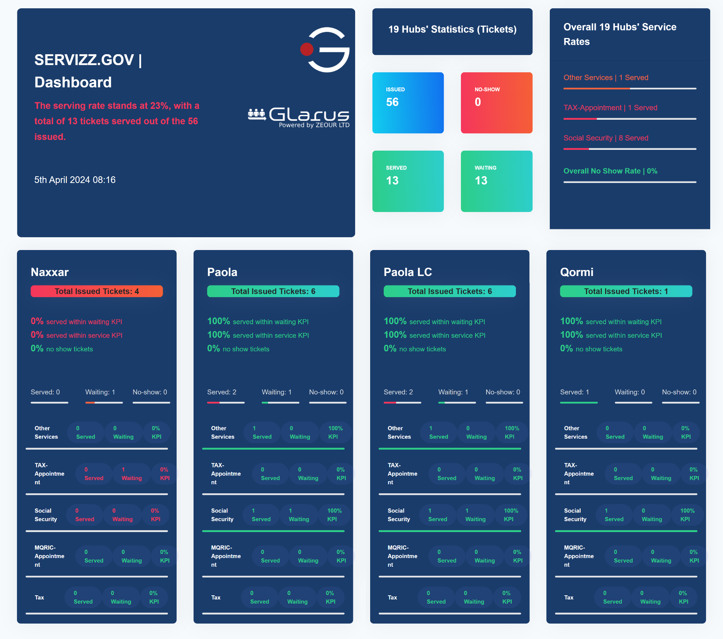

Slide 14
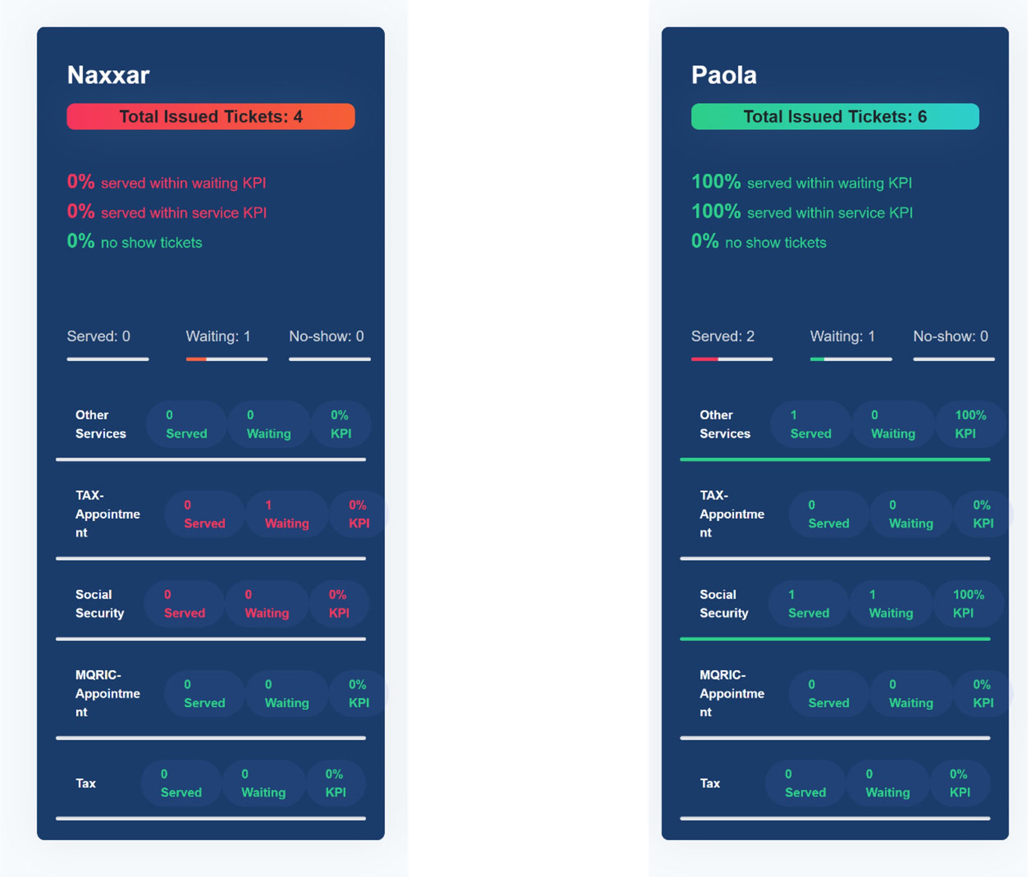

Slide 15
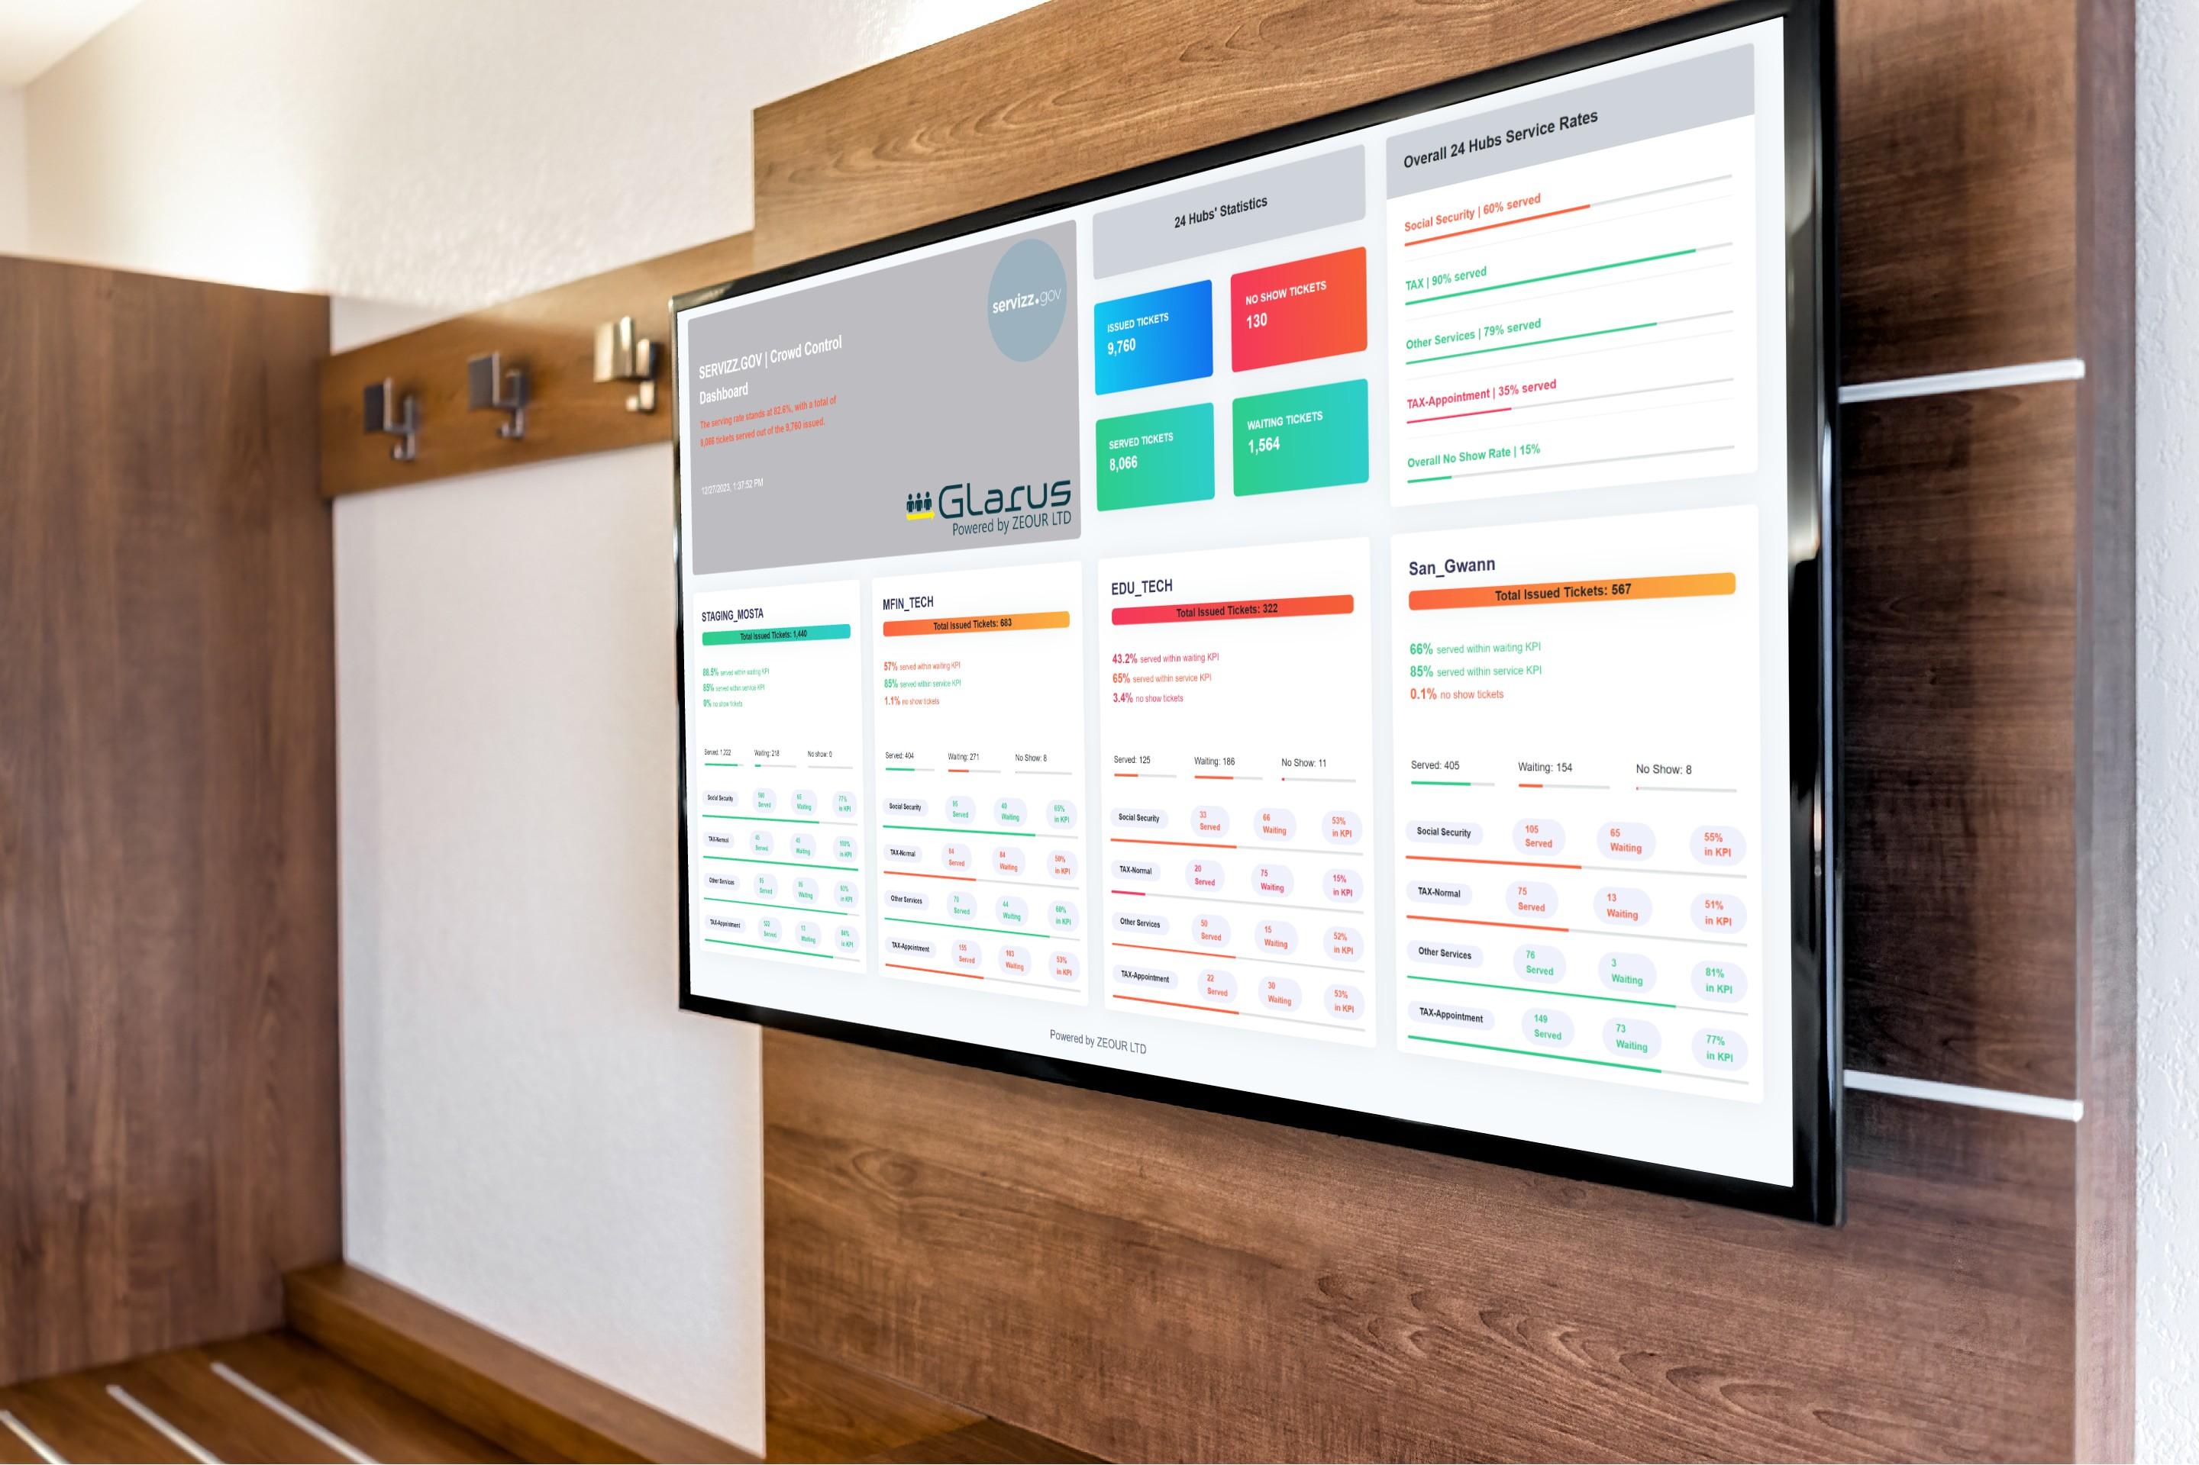

Slide 16
Customer Relationship Management (CRM)

Slide 17
CRM - Features
Microsoft Dynamics hosted on Azure
Used throughout Contact Centre, Ministries, Departments and Entities
  Case Escalation & Resolution
  Assignment of cases/queries
  History of cases
  Omnichannel approach whichever medium is used by client - Customer experience, Context, Content, and Collaboration
Understand (why and what) nature of queries
  Address such queries though other channels, e.g. FAQs, live-chat, automated messages
  User experience (UX)
  Service design issues

Slide 18
Digital Communication Channels

Slide 19
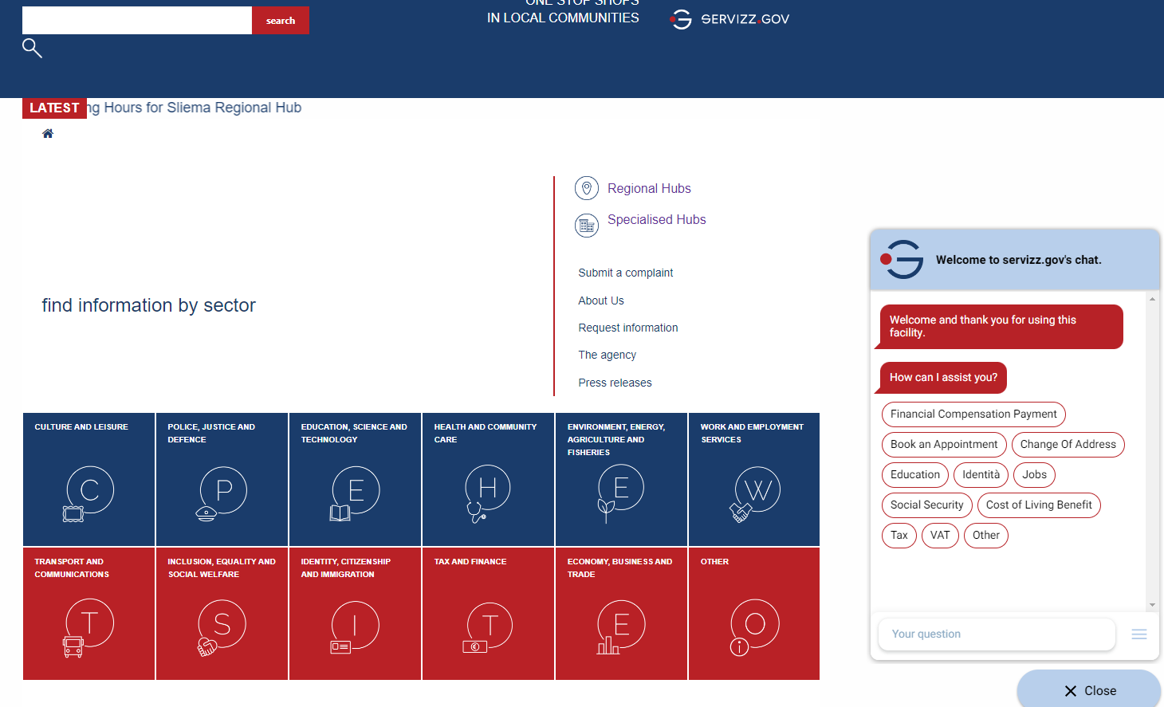
Servizz.gov - Current Portal
Search Feature
Services grouped
by Super Sectors
& Sectors
Chatbot & Live Chat

Slide 20
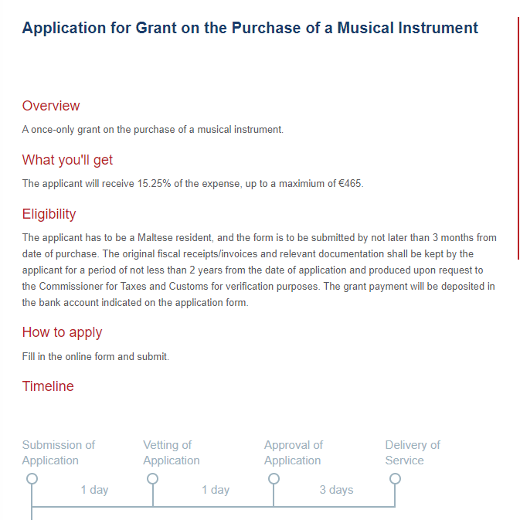
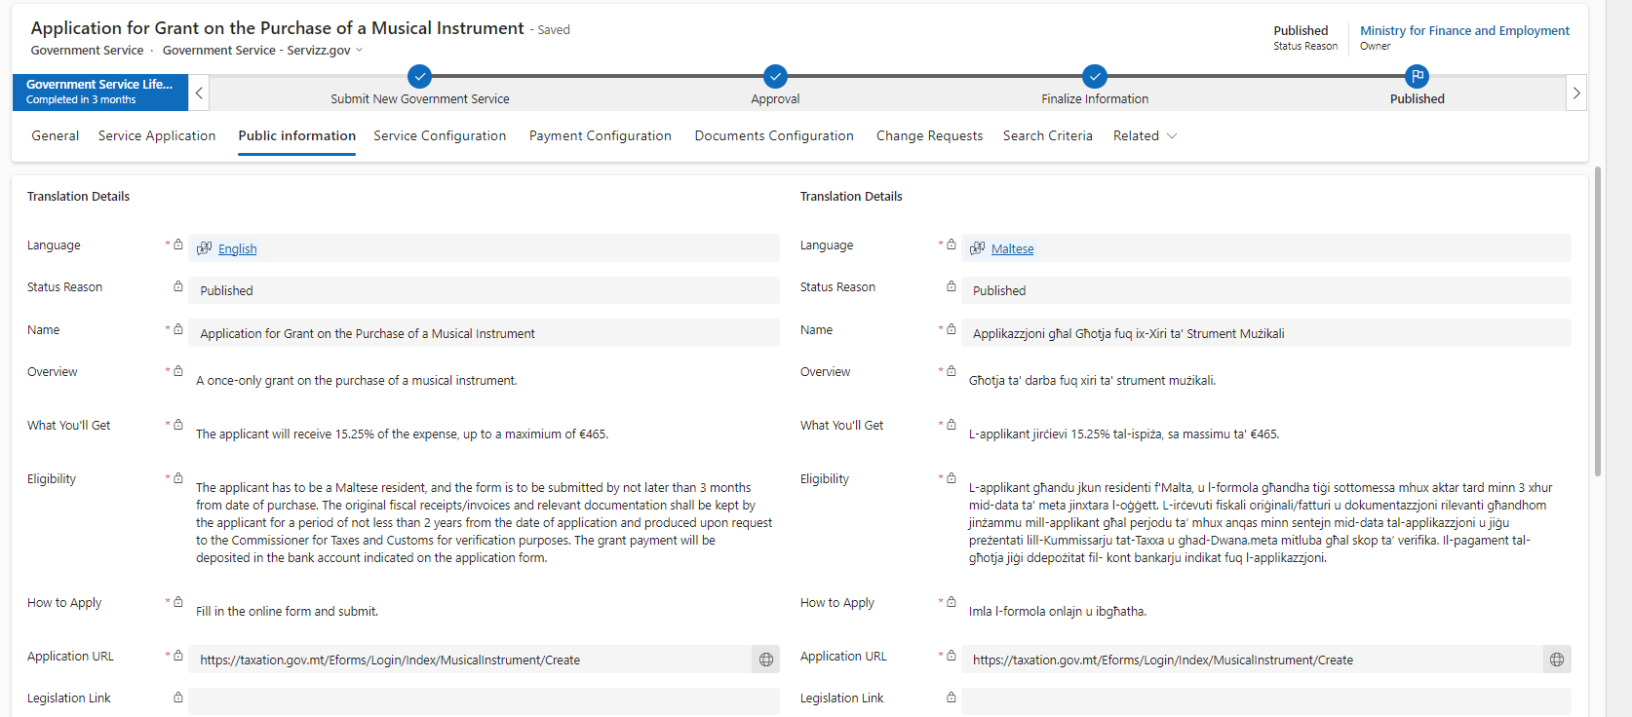
Online Services – Service Catalogue
Over 1600 government services accessible from servizz.gov.mt overarching portal
Business owners can update, add or delete services through MS Dynamics 365

Slide 21
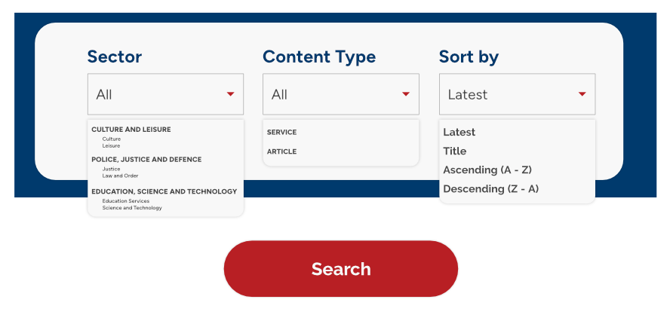
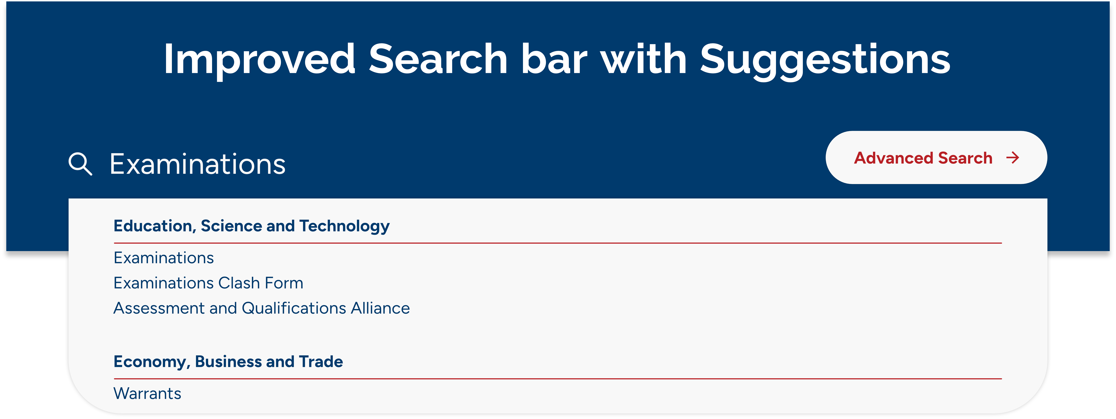
Future servizz.gov.mt Portal – RRP Funded
Super Sectors & Sectors
Prominent Search Bar with Auto Prediction
Life Events are given importance as an alternative way to explore services
Anonymous and Authenticated visits
Personalised Services - AI driven

Slide 22
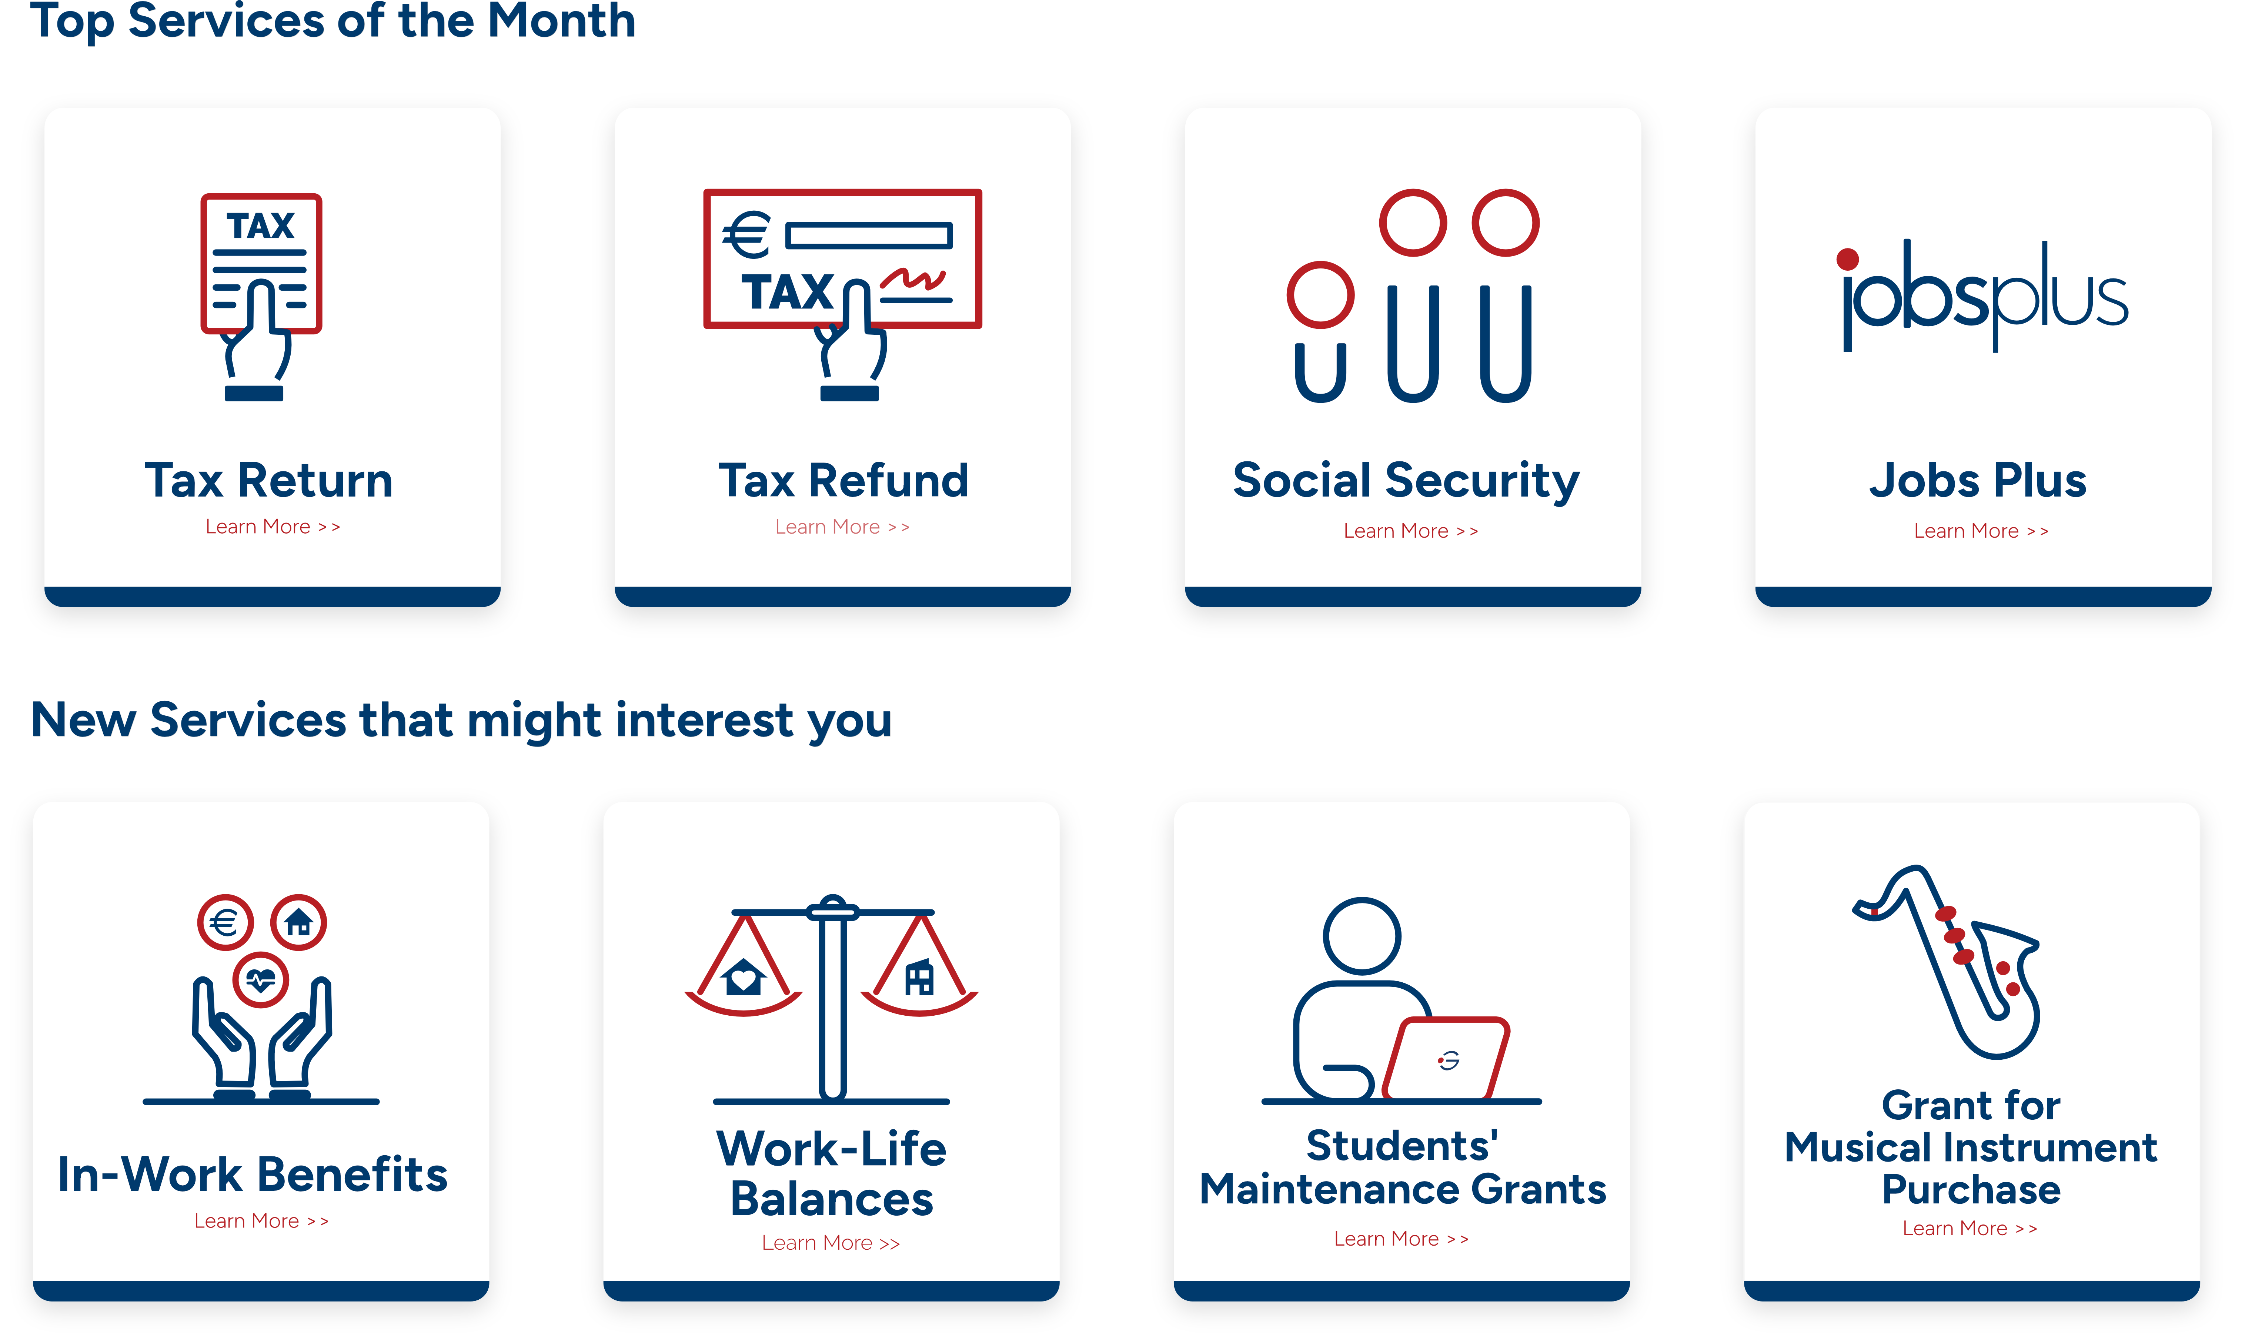
Personalised Services using Machine Learning
Dynamic Home Page:
Anonymised Users - Profile Wizard to generate recommended services. Trending services will also be displayed
Authenticated Users - an enriched personalised service providing recommendations based on the user persona and past service applications

Slide 23
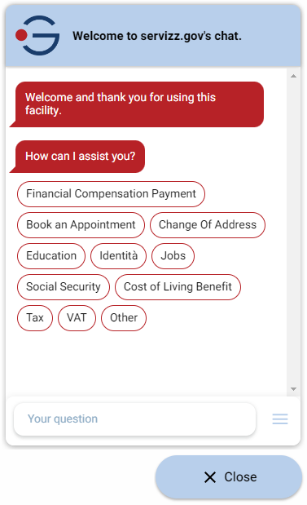
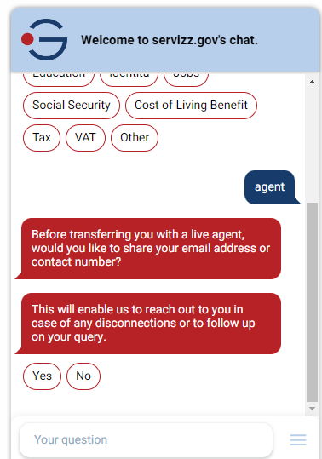
Chatbot & Live Chat
Nationally funded (MDIA)
One Chatbot for all Government Services (MT/EN).
ChatBot with FAQs and linked to all services available on the Service Catalogue reducing live agent interaction.
Developing an LLM-powered chatbot with advanced capabilities, focusing on minimising AI hallucinations, while providing natural interactions, meeting post-ChatGPT expectations.
Live Agent available during Office Hours.

Slide 24
How do we interact with Stakeholders?
Digitalisation Committee (member)
CIO Forum (member)
Executive Governance Board
Service Committee
Workshops with Focal Points (BOs) and Team Leaders
Bi-lateral meetings with Ministry Heads
Agent Training with BOs involvement (initial/ongoing)

Slide 25
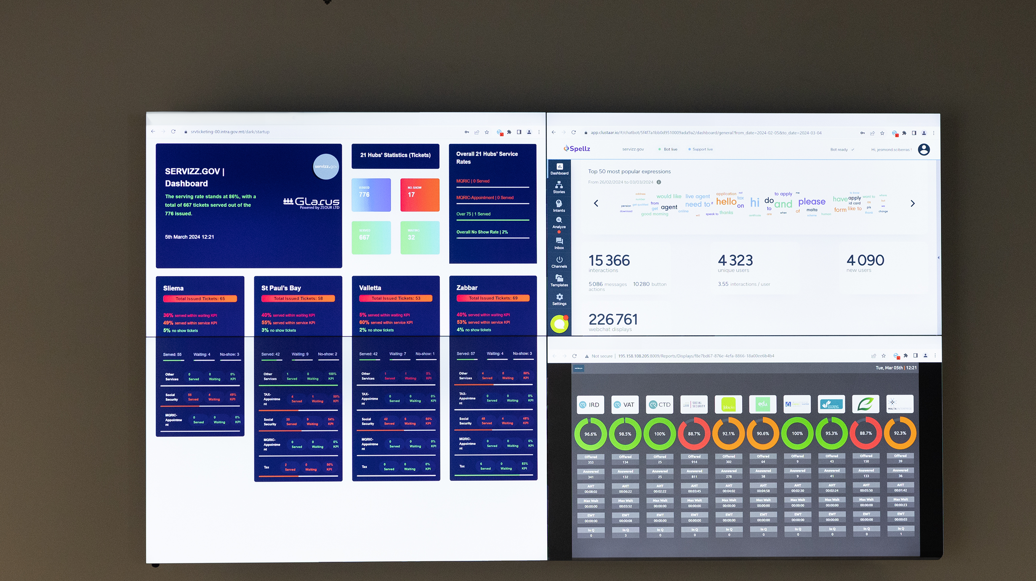
Unified Data Visualisation

Slide 26
Structural
Reform Support Programme (TSI)
- DigIT-X
March 2021 to February 2022
Digital and Interoperable
Public Services Designed on Client
Experience
Optimise 19 public services such that they become digital end-to-end
Main Deliverables
Documentation and analysis conducted during Business Requirements phase & Business Case phase
A report that documents and analyses the specific business scenario and requirements
Focus Groups to study the services
Focus on Service Design and UX
To-be recommendations
EU funded via SRSP (now TSI)
Notes:
Project began in January 2021
19 services (not 20) were optimised in the end; none have been implemented to date
It was suggested that a Project Review Board be set up to provide oversight to the outcomes of this project: to review the identified issues and recommendations, and follow the implementation of the 19 services, however this attempt did not succeed

Slide 27
List of recommendations via DigIT-X
Ministry | Name of service | No. of recommendations
OPM | Application for Address Management Unit (AMU) services | 11
MFIN | Registration of a share transfer | 10
MFIN | Application for Booking and Invoicing of a Customs Merchant Request Service (MRS) | 12
MEEP | Application for an import/export license | 11
MEES | Application for Agricultural Fund for Rural Development | 8
MLI | Digitalisation of Government Property Inventory | 6
MTP | Application for MTA Tourism License | 9
MSPC | Application for Childbirth and Adoption Bonus contributory benefit | 10
 | Application for Sickness Benefit (Blue Medical Certificate) | 11
 | Application for International Relations Unit (IRU) services (A1 & U1) | 6
 | Application for Marriage Grant | 6
 | Registration of a Social Security number | 6
MAFA | Application for Veterinary Prescription Booklet | 5
MHAL | Application for a local government/local council permit | 5
MJR | Application for Criminal Conduct Certificate | 10
MLI | Registration of a property transfer | 15
MTIP | Application for 3 Transport Malta Services | 7
 | Application for a Special Operating Permit | 13
Total |  | 186

Slide 28
Outcome
Project concluded in May 2022 with 186 recommendations
Working group to discuss recommendations and business owner's implementation plan
Findings discussed with Ministry CIOs during official CIO Forum
CIOs asked to report progress through the same channel
Project implementation is Work in Progress

Slide 29
Way Forward
Currently drafting a comprehensive 3-year strategy
Building on recent successes through specialisation and modernisation
Focus on sustaining momentum and embarking upon additional services
Ensuring policies are finely tuned to meet public needs and are user-centric
Leveraging gathered data
Harnessing the power of AI to improve service delivery

Slide 30
Thank you

