Slide 1

Unlocking excellence:
Harnessing cutting-edge technologies for a goal-oriented public sector with measurable results
Project:
Supporting the implementation of the new goal-setting and performance evaluation system in Greece (Law 4940/2022)
15 May 2024

Slide 2
Content
01
The project
04
Challenges
02
Background information
05
Key considerations
03
Outputs & expected results
06
Key figures
07
Technical approach

Slide 3

The project
Project: Supporting the implementation of the new goal-setting and performance evaluation system in Greece (Law 4940/2022)
Beneficiary: The Greek Ministry of Interior
Objective : Support the full implementation of a new goal-setting framework, ensure its successful rollout across the public sector, and drive a transformative shift towards a goal-oriented public sector.
The project builds upon previous recent technical support initiatives, representing a cohesive step forward in assisting reforms in the area of public sector HRM & development.
Project oversight is conducted by a Steering Committee comprising representatives from the Ministry, the DG REFORM, and the Reform Partner of France, which represents the French government (via the Embassy in Greece), along with Expertise France.

Slide 4
Background information
Back in 2023…
the Ministry of Interior collected numerous goal-setting forms from public administration units, stored digitally.
However, a thorough examination uncovered widespread issues: many forms were inaccurately filled, deviating from effective goal-setting guidelines, posing a risk of confusion and inefficiency across organizations, prompting a critical need for accurate goal formulation.
Given this finding, the accurate formulation of goals became a pivotal concern for the Ministry and, by extension, for the entire public administration.
The goal-setting form
(excel spreadsheet)

Slide 5
Outputs & expected results
Review & improvement of over 100.000 units’ goals for 2023 leveraging cutting-edge technologies in the areas of Robotic Process Automation (RPA) and Artificial Intelligence (AI). (completed).
Additional review & improvement of ~36,000 units’ goals from a representative sample of 40 public administration entities, with the support of a team of experienced analysts (completed).
Development of an application for the validation of goal-setting (the authors of the initial goals were invited to validate the proposals for improvement or appropriate adaptation by the AI and the analysts, after their own intervention, if any, using a special web application (completed).
Development of a tech-driven support mechanism for good goal-setting for future use in the next goal-setting cycles, based on the results of the first phase (in the design phase).
Implementation of change management and capacity building actions in public entities for good goal-setting (in progress).
Notes:
Review and improvement of over 100.000 goals contained in the 2023 goal setting forms of the organizational units of public administration entities, leveraging cutting-edge technologies in the areas of Robotic Process Automation (RPA) and Artificial Intelligence (AI). The improvement is based on the identification of deviations of the declared goals from the principles of good goal-setting and the requirements of Law 4940/22 (completed).
Additional review and improvement of ~35,000 goals included in the 2023 goal setting forms of a representative sample of 40 public administration entities, with the support of a team of experienced analysts (completed).
Development of an application for the validation of goal-setting (the authors of the initial goals were invited to validate the proposals for improvement or appropriate adaptation by the AI and the analysts, after their own intervention, if any, using a special web application (completed).
Transfer and connection of goals with the environment of the main HRM system of the MoI to serve the subsequent process of evaluation of the Units’ managers by their supervisors (in progress).
Development of a Digital Assistant to be used in the future goal-setting cycles, based on good practices, the work of the analysts and the AI suggestions, for use by all public entities in Greece (in the design phase).
Development of a support mechanism for good goal-setting for future use in the next goal-setting cycles, based on the results of the first phase (in the design phase).
Implementation of change management and capacity building actions in public entities for good goal-setting (in progress).

Slide 6
Challenges
Managing an excessively large volume of information within a very short timeframe
Validation of adjusted goals by authors crucial for adherence to smart goal-setting principles; the process includes adjustments from AI recommendations or expert analysts, aligning with smart goal-setting principles
Minimize any scepticism among public servants regarding the utilization of AI in the goal-setting process to the greatest extent possible.
Implementation of awareness and engagement initiatives for public administration managers, aiming to secure full support for reform efforts and promote a culture prioritizing measurable results.
Integrate the forms into the main HRM web app while maintaining data integrity, functionality and usability.
Notes:
From the outset, it was firmly established that goal-setting should stem from the intentions and decisions of the original author, namely the evaluator of the unit manager. Therefore, it was imperative that the authors validated any improved or appropriately adjusted goals identified in the 2023 goal-setting forms. These adjustments could have originated either solely through the utilization of AI recommendations or through recommendations from the team of expert analysts, which took into account the initial proposals of AI. This validation process aimed to ensure adherence to the principles of effective (smart) goal setting.

Slide 7



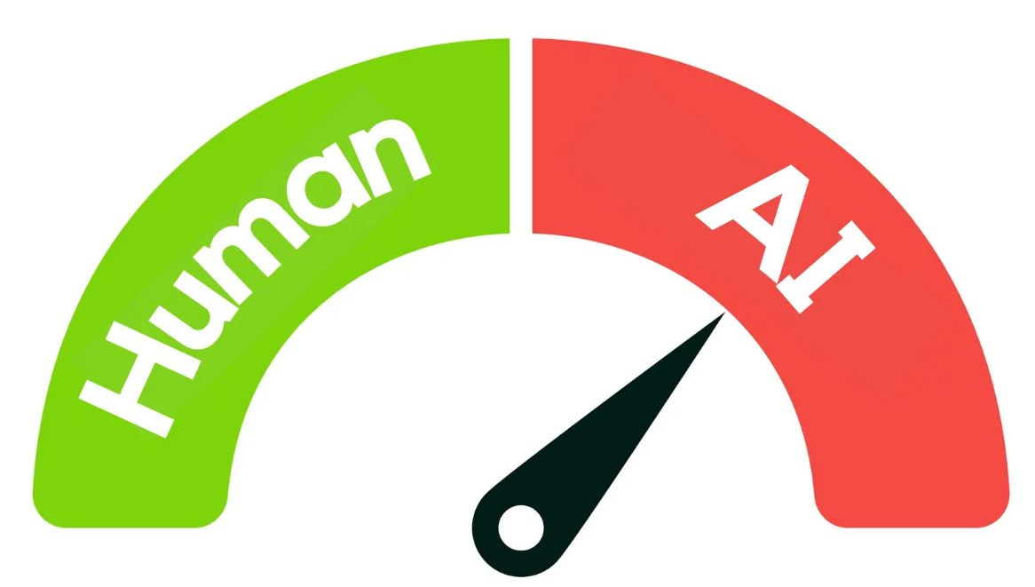
Key considerations
Ministry objectives: Focus on supporting entities rather than imposing goals; aim for well-defined goals to improve public services and citizen satisfaction.
AI role: Serve as a supportive tool, not a replacement for human involvement.
AI system limitations: Acknowledge AI's valuable insights but recognize its limitations in understanding organizational intricacies; suggestions may not always consider all factors.
Collaborative goal-setting: Combine AI's analysis with human experience and judgment for comprehensive goal development.
Notes:
Ministry objectives: The MoI focuses on providing support rather than imposing goals on other entities and their organizational units. This support aims to facilitate the development of well-defined goals, with the overarching goal of improving public services and enhancing citizen satisfaction.
AI serves as a supportive tool that cannot and should not replace the human factor.
AI system limitations: While AI offers valuable insights, it may not always fully grasp the intricacies of a public organization's operations. As a result, the suggestions it provides for goal improvement or adjustment may overlook certain important factors, may not always be successful. While these suggestions should be taken into account, they are not obligatory for adoption, allowing for human judgment and contextual understanding to prevail.
The collaborative approach in shaping goals, which ultimately combines the analytical power of AI with the experience and judgment of the human factor, ensures a comprehensive and effective decision-making process.

Slide 8
Key figures
Note: All figures are dynamic, as there are ongoing processes of fine-tuning the goal-setting.
958
20.101
+ 6.562
Public sector entities
Goal-setting forms 2023
Goal-setting forms 2023
submitted goal-setting forms for 2023, which were processed by RPA, AI, and, where necessary, by analysts, followed by validation by their managers.
posted in the Ministry's private repository and subsequently retrieved
were added by the end of the validation process of the results of goal processing by RPA and AI.

Slide 9
Key figures
Note: All figures are dynamic, as there are ongoing processes of fine-tuning the goal-setting.
100.460
155.376
36.452
Goals
14.01.2024
Goals
21.04.2024
Goals
12.03.2024
underwent mechanical processing and examination through AI
underwent mechanical processing and examination through AI
Many entities were called upon to retrospectively correct their goals or add new appropriate ones which were also assessed by the ΑΙ tool
underwent mechanical processing, examination through AI and the team of analysts
Goals from the representative sample of 40 public administration entities

Slide 10
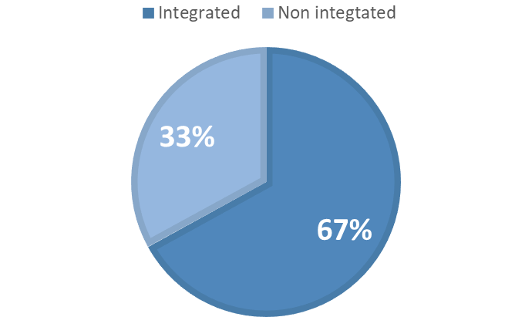
Key figures
Note: All figures are dynamic, as there are ongoing processes of fine-tuning the goal-setting.
Most common errors observed overall include:
  Approximately 40% of goals lacked adequate measurability.
  Around 60% of goals were not appropriately time-bound.
At the outset of the process, only about 9% of the goals were evaluated as fully SMART.
Estimation of the integration rate of the AI recommendations into the goals:
67%
It is estimated that the percentage is even higher when considering the goals added retrospectively, based on guidelines for effective goal setting

Slide 11


Technical approach
RPA – AI - Apps
The AI tool

Slide 12
Technical approach
RPA
Data retrieval
A.I.
Goal processing
Apps
Analysts' recommendations
Goal setting forms search
Machine matching
Issue identification
SMART analysis
Indicator identification
Improvement proposals
Goal setting forms matching with units
Goals updating

Slide 13
Technical approach
Non-successful examples of goal setting
  Reduction of response time to citizen requests for issuing a certificate
  Enhancement of knowledge and skills of the organization's personnel.
Successful examples of goal setting
  Decrease the average response time to citizen requests for issuing a certificate by X (absolute number or X%) by December 31 of the year compared to the previous reporting period or the current status.
    Indicator: Average response time (days) - (number or X%)
  Increase the number of trained employees in Program X, as a percentage of the total workforce of the Directorate, by X% by December 31st of the year compared to the previous reporting period.
    Indicator: Number of employees trained in Program X (number or X%)

Slide 14
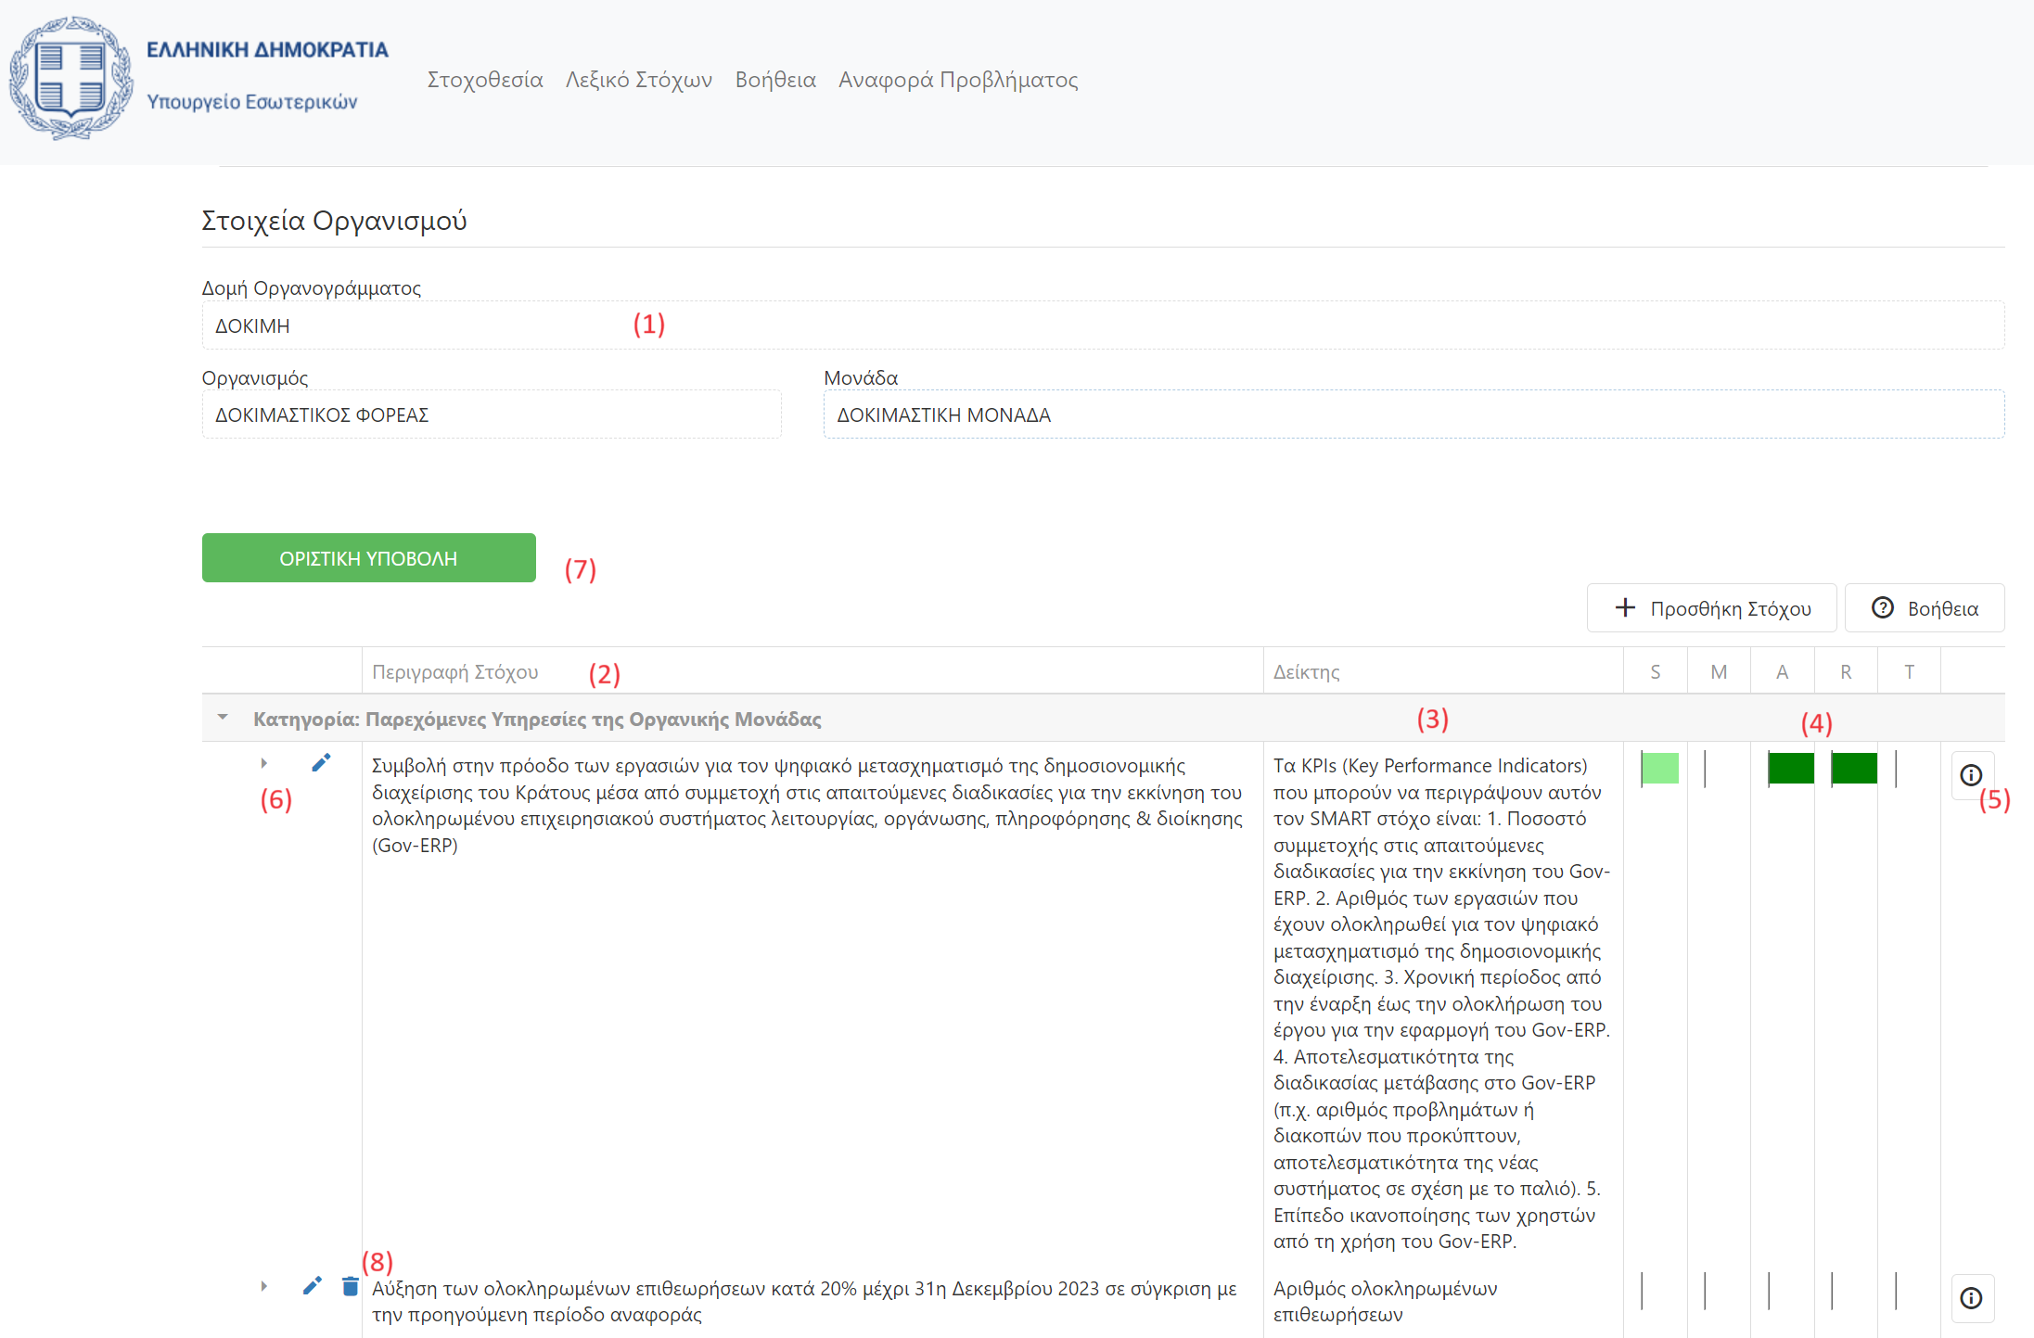
Technical approach – The tool
Description of Goal: In most cases, the text recorded in the goal-setting form is provided verbatim. In some instances, where multiple goals were contained within a single cell, and automatic segmentation was feasible, they are displayed as distinct entries.

Slide 15
Technical approach – The tool
Indicator: An automatic suggestion is provided regarding the most useful and relevant key performance indicator (KPI) that can be used to measure the goal's achievement

Slide 16
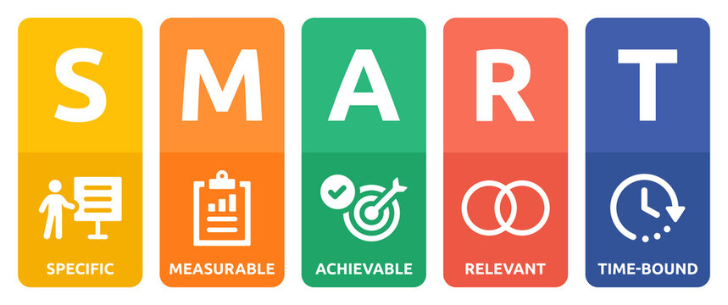
Info button: The rationale behind the automated SMART analysis is provided primarily to further assist in understanding the individual criteria.
Technical approach – The tool
SMART: Indicative results of the automatic analysis of the goal are provided based on the 5 smart criteria

Slide 17
Technical approach – The tool
Example
Assessment:
Specific: Compliance rate 60% - The goal is clear in its intent but lacks specifics.
Measurable: Compliance rate 80% - Reduction implies a measurable aspect, but a target percentage is missing.
Achievable: Compliance rate 70% - Achievability depends on the current volume and nature of requests/cases.
Relevant: Compliance rate 100% - Reducing pending requests/cases is relevant to the position of Managers.
Time-bound: Compliance rate 0% - The goal lacks a timeframe for achieving the reduction.
Recommended Improvements:
Define the type of requests/cases; Define a target reduction percentage; Determine a realistic reduction target; Set a specific timeframe for achieving the target reduction (e.g., by the end of the year).
The goal could be reframed as follows : Reduce pending employee IT support tickets by 20% within the year (e.g. baseline: 100 tickets) by implementing a new ticketing system by the end of 2023
KPI: Percentage reduction in pending IT support tickets
  Initial goal:
  Reduction of pending requests/cases related to the employees of the organization
  KPI: Percentage reduction in pending /cases

Slide 18
Technical approach – The tool
Example
Assessment:
Specific: Compliance rate 0% - It's unclear what exactly is meant by "defining the scope of work for each administrative staff member." This goal needs to be more specific
Measurable: Compliance rate 0% - There is no provision for how the achievement of this goal will be measured
Achievable: Compliance rate 0% - It's unclear if this goal is realistic or achievable based on the resources and capabilities of the organizational unit.
Relevant: Compliance rate 50% - It may be relevant to the purpose of the organizational unit, but without more information, we can't be sure
Time-bound: Compliance rate 0% - There is no mention of a timeline or deadline for achieving this goal.
Recommended Improvements:
The goal could be reframed as follows "Defining and categorizing the tasks and responsibilities of administrative staff by the end of 2023, aiming to improve efficiency and effectiveness by 20%
From this specific goal, there are no specific KPIs derived. However, based on this goal, we could consider some potential KPIs such as:
Number of items handled by each administrative staff member; Percentage of administrative staff working on each item; Time spent by each administrative staff member on each item.
Please clarify the goal so that I can provide more precise KPIs.
  Initial goal:
Define the scope of work for each administrative staff member.

Slide 19
Technical approach
Next step: Develop Digital Goal Assistant for efficient annual goal-setting in public administration.
Key features:
Interactive Goals’ Dictionary:
  Curated by analysts from 2023 goal data and Ministry plans.
  Easy access to diverse goals based on criteria and meta-tags.
AI Prompt:
  Customizable tool for generating goal-related responses.
  Incorporates SMART goal examples from 2023 for refinement.
Notes:
Features:
Interactive Goal Dictionary:
Curated by a team of analysts leveraging experience from examining thousands of goals for 2023.
Draws insights from the Annual Action Plans of each Ministry, industry best practices, and 2023 goal data.
Facilitates easy access to a vast repository of goals based on criteria (e.g., goal categories) and meta-tags (e.g., goals tied to economic objectives).
Supported by administrative interfaces ensuring sustained usability beyond the 2024 goal-setting cycle, with options for further goal enrichment, filtering, and meta-tagging.
AI Prompt:
Empowers users to input concise proposals or queries into an artificial intelligence system for generating responses or texts.
Highly customizable to meet specific needs.
Integrates examples of successful SMART goal-setting from 2023 data, aiding in goal refinement.
The Digital Goal Assistant, alongside its administrative toolkit, will seamlessly integrate into a unified online platform within the Ministry's infrastructure, housed on the Governmental Computing Cloud G-Cloud. Accessible through specialized support channels, it will play a pivotal role in facilitating the Census implementation at apografi.gov.gr.

Slide 20
Thank you for your attention

