Slide 1
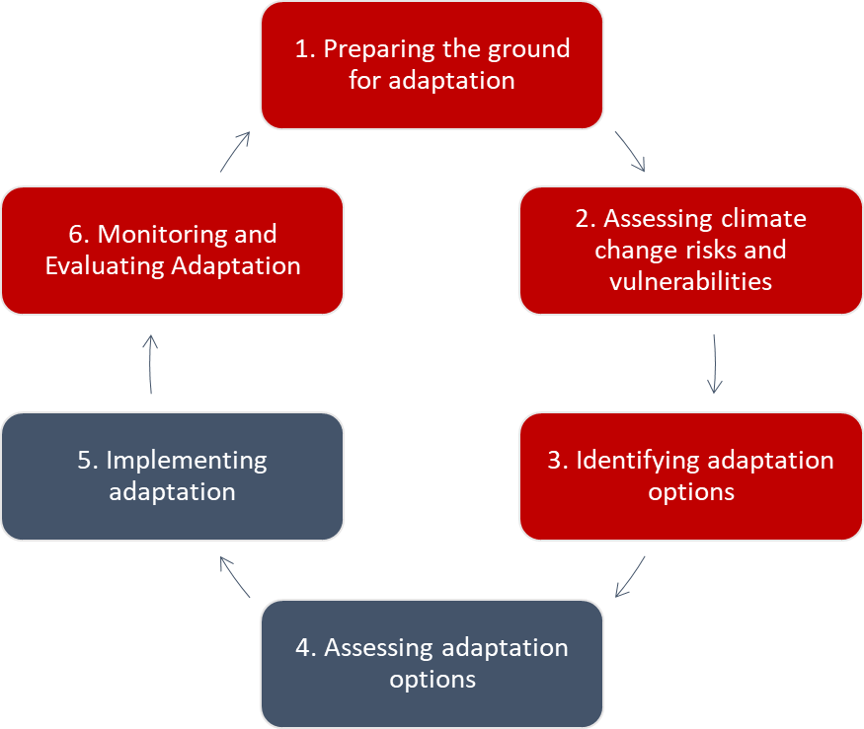
Action 1 - Support Member States in updating their national Climate Adaptation Strategies and plans - from Q1 2024
Green transition Pillar – Shaping the green transition
Climate adaptation
Circular economy
Pollution prevention & control
National administrations of the Member states are encouraged to use the Commission notice on how to prepare adaptation strategies and plans
Climate mitigation
Water
Biodiversity
Upon which, Ministries and agencies get involved in a « 6 steps process »:
That, also includes conducting and updating national and sub-national climate risk assessments

Slide 2
Action 2 - Uptake of climate proofing guidance - from Q1 2024
Green transition Pillar – Shaping the green transition
What is the carbon footprint of the investment?
Climate adaptation
Circular economy
Pollution prevention & control
Biodiversity
Water
What are the climate risks/vulnerabilities of the investment?
What is climate proofing?
‘a process integrating climate change mitigation and adaptation into the development of infrastructure projects’. See technical guidance
Closely linked to or part of (strategic) environmental assessments
Provides pre-condition for 2021-2027 EU funding (regional funds, EIB loans & grants)
Supports implementation of the Do No Significant Harm principle

Slide 3
Action 2 - Uptake of climate proofing guidance and other environment-relevant guidance - from Q1 2024
Green transition Pillar – Shaping the green transition
Climate mitigation
Climate adaptation
Water
Circular economy
Pollution prevention & control
Biodiversity
Member States (central administrations and regions) are encouraged to use green budgeting a tool for evidence generation and policy coherence to redirect public investment, consumption and taxation to green priorities and away from harmful subsidies.
National public authorities can develop green public procurement (GPP): 2020 Circular Economy Action Plan defines minimum mandatory GPP criteria and targets in sectoral legislation (clean vehicles, energy efficiency, buildings).
In support to the implementation of the Do No Significant Harm principle

Slide 4
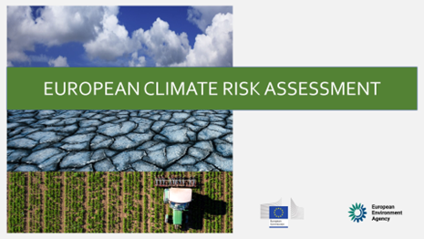
Action 3 - Promote tools and methods for climate risk assessments and risk prevention - from Q1 2024
Green transition Pillar – Shaping the green transition
Member States encouraged to use Climate-Adapt to identify adaptation-related policy priorities and investment priorities and support policy development in climate-sensitive sectors (such as public health)
Water
Pollution prevention & control
Biodiversity
Disaster resilience goals
Member States to identify and address risks using the Disaster Risk Management reports (~March 2024) and prepare for the revision of reporting and risk assessment guidelines in Q2 2024. (Next submission of Member State reports mid-2024 and end 2026).
Support and learning available to the Member States: Peer review programme; Grants for projects (new call launched 16 January); EU Civil Protection Mechanism technical assistance.

Slide 5
Action 4 - Support Member States to develop capacities to plan, design and implement ecosystem restoration measures and nature-based solutions to maintain essential ecosystem services - from Q2 2024
Green transition Pillar – Shaping the green transition
Tools
Countries’ best practices
Guidances
Other
NbS case Studies
Member States to implement the Nature Restoration Law (entry into force: mid 2024) and submit Nature Restoration Plans (by mid 2026) Template under discussion with MS – NRL focal points. Support by the European Environment Agency and the EU Biodiversity Platform
Member States to mobilize financial resources and find support through the EU Biodiversity Platform, technical assistance and advisory via the TSI annual call, Green Assist, LIFE Strategic Nature Projects, peer to peer exchange TAIEX-EIR P2P.
Implementing the Nature Restorations Plans and the Global Biodiversity Framework
Information available in the New Guide for EU Funding Programmes for the environment - European Commission (europa.eu).
Guidance to MS:
RTD NBS tools, EIA study on investing in NBS

Slide 6
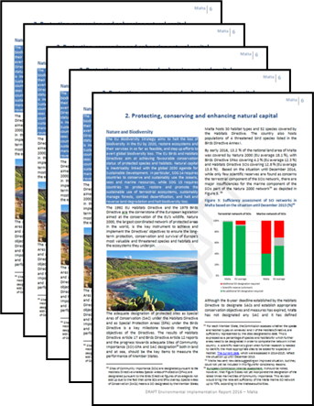
Action 5 - Identify the root causes of insufficient implementation of environmental legislation and policy using the Environmental Implementation Review - from Q2 2025
Green transition Pillar – Shaping the green transition
Climate mitigation
Climate adaptation
Water
Circular economy
Pollution prevention & control
Biodiversity
Commission Communication & 27 Country Reports identifying shortcomings and proposing priority actions in all environmental sectors,
Environmental Implementation Review (EIR)
Includes examination on the crosscutting enablers of environmental financing and environmental governance (access to information, access to justice, public participation, env. liability, env. crime),
Governance includes a qualitative assessment of administrative capacities, green skills & co-ordination, with inputs from the European Semester, Cohesion & RRPs,
Comprehensive assessment of progress in priority actions since 2022 EIR.
MSs’ environmental administrations to be consulted on draft country reports Q1 2025
Next EIR release: May 2025 tentative (tbc)
MSs EIR dialogues (stand-alone events or within infringement package meetings)
Environmental Implementation Review - European Comwith mission (europa.eu)

Slide 7
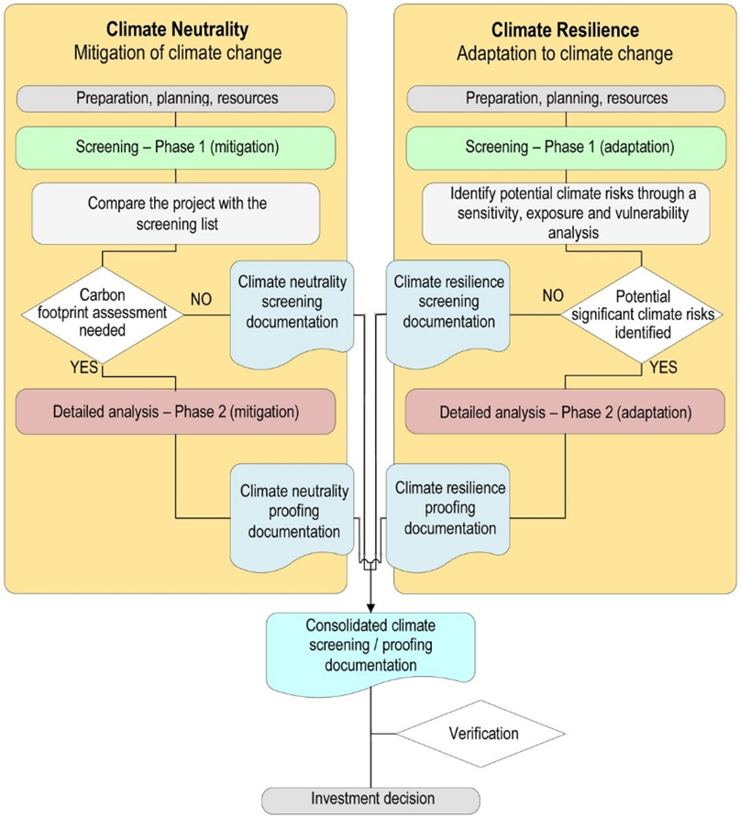
Action 2 appendix - Uptake of climate proofing guidance and other environment-relevant guidance - from Q1 2024
Green transition Pillar – Shaping the green transition
Climate mitigation
Climate adaptation
Water
Pollution prevention & control

Slide 8
Action 1 - Develop further guidance on the use of the EU Eco-Management and Audit Scheme - from Q4 2023
Green transition Pillar – Promoting the greening of the public administration
Tools
Countries
Case Studies
Other
Other
Other
Member States to refer to the user’s guide setting out the steps needed to participate in the EU eco-management and audit scheme (EMAS) - adopted on the 3 November 2023
National experts to contact the Competent Bodies in EMAS in their country for more information on the registration process. All contact details can be found EMAS in your country (europa.eu)
Eco-Management and Audit Scheme (EMAS) (europa.eu)

Slide 9
Action 2 – Facilitate access to technical support and guidance for decarbonization and improving overall sustainability of buildings
Green transition Pillar – Promoting the greening of the public administration
Tools
Countries
Other
Other
Other
Case Studies
Member States to renovate every year to near zero-energy or zero emissions buildings (NZEB) 3% of the surface for the buildings owned by public bodies by 2040.
Further guidance and tools in support of building renovation implementing the requirements of article 6 of the Energy Efficiency Directive (EED) and using the renovation passport.

