Slide 1
Quality of Public Administration
A Toolbox for Practitioners
Notes:
Presentation to Expert Group, 26 June 2024

Slide 2
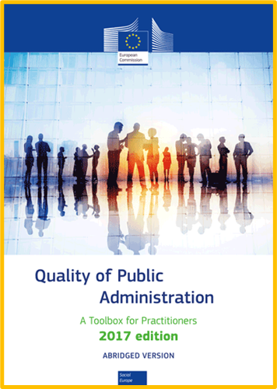
What is the Toolbox?
A compendium – pooling knowledge & experience from Member States, European Commission, internationally
Non-prescriptive and user-friendly guide– information, orientation and inspiration for discussion with practitioners and stakeholders
Theory and practice – principles, approaches and inspiring examples (secondary sources) + 45 more in-depth case studies (research and interviews) as new feature
Country case studies - 50% from Expert Group recommendations, others based on EPSA, OPSI, TSI etc. covering all Member States and PAG themes.
Being updated !
Notes:
The Toolbox presents the EU’s collective knowledge on PAG, both from Member States and the Commission and other EU institutions, but also international bodies such as OECD and UN, and 3rd countries where useful.
Importantly, it is a guide, it doesn’t prescribe, and it aims to be reader-friendly to inspire and prompt discussion.
It combines both theory (key messages) and practice, highlighting for example Commission policies, EU laws, funding programmes etc, and draws heavily on Member State approaches. For this latest edition it will contain ‘inspiring examples’ from MS, drawn from existing sources, updated where possible from contacts in the administrations, and now, as a new feature ‘case studies’, prepared by the EUPACK team.
There will be 45 case studies – half of which come from the recommendations from EG members, which we appreciate greatly, along with all your support in reaching contacts in your administrations when needed. The rest are built on other sources, such as TSI projects, EPSA, OPSI, Crystal Scales of Justice, to ensure we have a good thematic balance and geographical coverage. All MS are represented.

Slide 3
Why is it important?
Presents common Commission understanding on main issues
Promotes national practices and EU tools
Basis for learning & knowledge-sharing
Basis for dialogue & exchange with Member States:
Guide how on design and implementation of reforms
Help Member States prepare better projects
Foster innovation
Directly linked to the implementation of ComPAct (action under Pillar 1.4 on tools for PAG)
Notes:
Why do we need a Toolbox?
First, it’s the place where we bring together the Commission’s position and understanding on a diverse set of PAG issues such as regulatory reform, digitalisation, anti-corruption, competency frameworks, sustainable development, green procurement, and so on.
The first edition was produced in 2015, and it’s seen very much as a tool for learning, sharing knowledge, stimulating dialogue, especially around European Semester and use of EU funding including TSI and Cohesion Policy funds, and fostering innovation.
This update of the 2017 Toolbox was a commitment in the ComPAct, and the Toolbox itself is fully aligned with the 3 pillars.

Slide 4
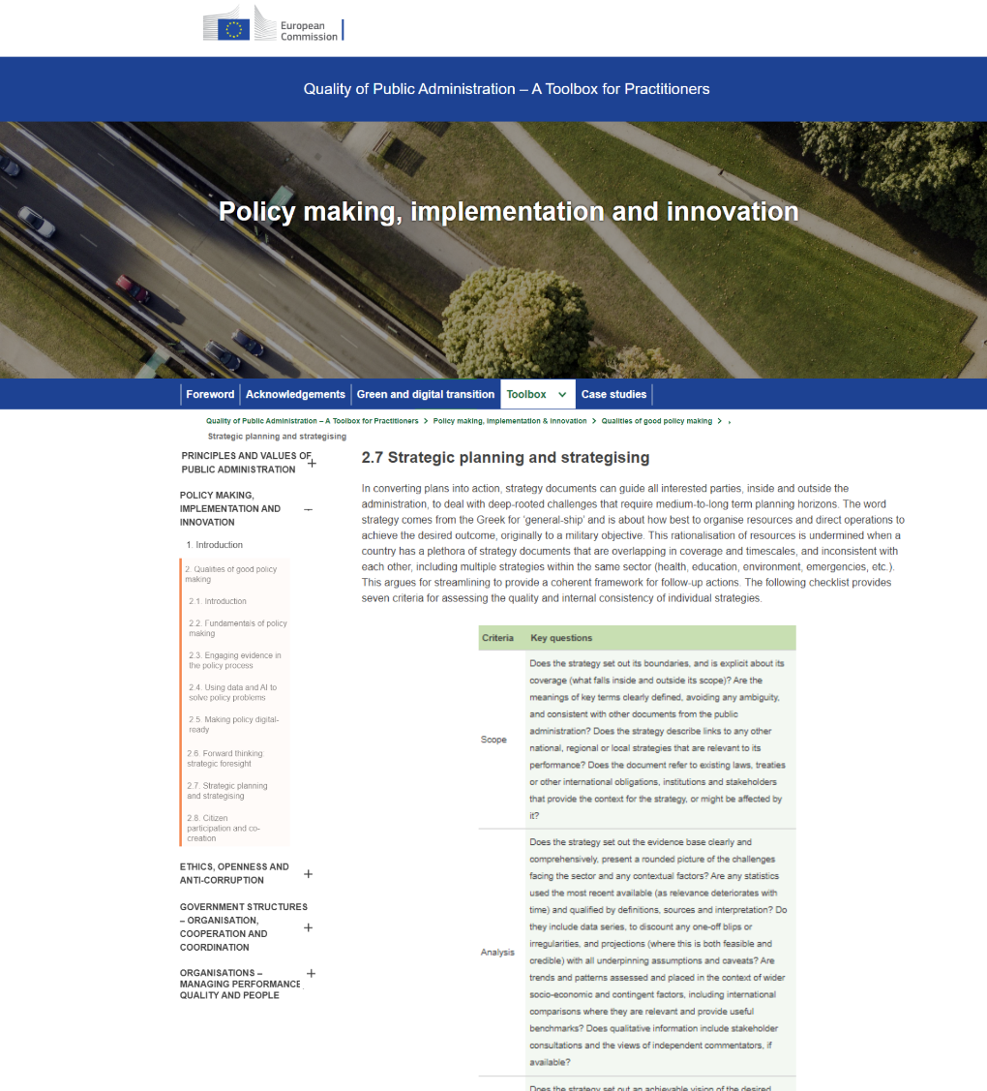
How will it work?
Fully HTML on Europa
Landing page > principles of good governance + 9 thematic chapters + ‘becoming a digital administration’ + ‘becoming a green administration’
Easy to navigate within and across chapters, with clickable links to related topics and country cases, and external sources
Not a publication, so updatable
Sample topic mock-up
Notes:
For the first time, the Toolbox will be fully online, not a series of downloadable PDF chapters. The image on the right is a rough mock-up to give you a ‘feel’ for how it might look when published.
Most crucially this will make it a lot easier to navigate, as we can connect topics simply with a click on a link – no more having to download another chapter to read about a related issue or country case, the Toolbox will now take you directly to it. Also, being online it will be easier to update and expand with new developments.
As you’ll see from the slide, it follows the usual format of a landing page to introduce the userr to the Toolbox’s purpose, structure and how to read it. It then drills down into themes and topics, namely principles of PAG, 9 thematic chapters, and two overview topics on the twin transitions: green and digital.

Slide 5
What is the thematic coverage?
Policy making, implementation and innovation
Ethics, openness and anti-corruption
Governance: structures and systems, organisation, cooperation and coordination
Organisations - managing performance, quality and people
Service design and delivery
Business environment
Effective justice systems
Public finance, procurement and EU funds management
Public administration reform and modernisation – making positive change happen
Notes:
We’ve presented these before, so this is a recap. The nine thematic chapters mirror the structure of the 2017 Toolbox, updated to reflect latest knowledge. A lot has changed in the last 7 years. The intention remains the same, however - to cover all major PAG issues.
To dive a little deeper, and show you what is new and different, we present examples from a couple of chapters: policy and finance, as well as a cross-cutting theme: becoming a digital administration.

Slide 6
Example: Policy
Overview of content
Themes | Topics | What is new and different?
Qualities of good policy making | Fundamentals of policy making Informing policy with evidence Using data to solve policy problems Making policy digital-ready Future-proofing policy with foresight Strategic planning and strategising Citizen and stakeholder participation | Greater emphasis on evidence-informed policy making, including use and re-use of data, potential of AI New: digital-ready policy making Expansion of citizen engagement, focusing on deliberative democracy and co-creation
Instruments of policy implementation* | Laws and the regulatory environment Achieving policy goals by changing behaviour Co-production | Developments in the EU Better Regulation agenda More experience with applying behavioural insights
Continuous improvement and innovation | Monitoring, evaluation and performance audit Encouraging external scrutiny Fostering innovation | Opportunities for openness due to digitalisation More experience with stimulating policy innovation
* Note: this theme links to other instruments in other chapters, specifically service design and delivery, public finance (spending and taxation), public procurement, and institutional arrangements (multi-level governance)
This theme also sets the scene for the ‘business environment’ chapter, as does the ‘services’ chapter
Notes:
For example, the policy chapter comprises three main themes to reflect the title: policy making, implementation and innovation.
Each theme consists of a set of topics.
The overall coverage is the same as the existing Toolbox but with extra emphasis and extension, to reflect PAG as we find it in the mid-2020s, the state of poly-crisis, the growth of digitalisation, the advent of AI, the tackling of climate change, and the greater awareness of involving citizens. You see this reflected in the ‘new and different’ column.

Slide 7
Example: Policy
Case studies
PlanAPP & RePLAN (Portugal)
TAP Portal (Latvia)
Brno 2050 (Czech Republic)
Citizen’s assemblies (Ireland)
Digital-ready legislation (Denmark)
Strategy.bg (Bulgaria)
Innovation Lab (Latvia)
Notes:
In this chapter, we present 7 case studies:
from the central (the PlanAPP Competence Centre for Planning, Policy and Foresight in Public Administration and RePLAN ministerial network in Portugal) to the local (the 2050 strategy in the Czech city of Brno)
from the digital (Bulgaria’s strategy.bg platform and Latvia’s TAP single portal for developing and harmonising draft legal acts) to the digital-ready (Denmark’s pioneering work on changing the way that laws are prepared, with Commission support),
and finally, Ireland’s equally ground-breaking citizens’ assemblies to bring the public into policy making).
Note, other than digital-ready legislation which builds on a TSI project and was proposed by JRC and DG DIGIT, and Brno 2050, which was recommended by the EUPACK country expert, all others come from EG members’ response to the Survey.

Slide 8
Example: Digital administration
Overview of content
Themes | Topics | What is new and different?
Becoming a digital administration | Digital governance and ‘digital by design’ Interoperability and key enablers Artificial intelligence (AI) Cybersecurity | New overview ‘chapter’ made possible by online format Core policies, laws and ingredients of digital transformation Reference for digitalisation elsewhere in Toolbox Links to related topics: digital-ready policy, using data in policy making digital services, e-Procurement, digital skills, governance in a digital world, e-Justice, etc.
Notes:
This cross-cutting topic of ‘becoming a digital administration’ is the logical outcome of an online Toolbox, as it sets the scene and acts as a central reference for digitalisation and digital transformation which are topics that are present throughout the Toolbox (as with ‘becoming a green administration’). For this reason, not everything connected to digitalisation is assembled here – it doesn’t need to be. Instead, it contains core information on governance, the key concept of digital by design, the architecture of digitalisation (interoperability and key enablers, such as base registries, digital ID, APIs) and the topics of the moment: AI and cybersecurity.

Slide 9
Example: Digital administration
Case studies
Authority for Digitalisation of Romania (ADR) and Digital Policy Lab (Romania)
AuroraAI (Finland)
Building AI-powered government (Estonia)
Notes:
In this ‘chapter’, we present 3 case studies:
ADR, proposed by the EG member for Romania, and which has received extensive support from the EU including in launching the Digital Policy Lab, also links well to the policy and governance themes
And given its prominence as a hot topic in PAG, we have two case studies on AI, unsurprisingly from Estonia and Finland, inspired by an OPSI case study and the presentation by Dr Velsberg at the October EG meeting
from the digital (Bulgaria’s strategy.bg platform and Latvia’s TAP portal …) to the digital-ready (Denmark’s pioneering work on changing the way that laws are prepared, with Commission support),
and finally, Ireland’s equally ground-breaking citizens’ assemblies to bring the public into policy-making).
Note, other than digital-ready legislation which builds on a TSI project and was proposed by JRC and DG DIGIT, and Brno 2050, which was recommended by the EUPACK country expert, all others come from EG members’ response to the Survey.

Slide 10
Example: Finance
Overview of content
Themes | Topics | What is new and different?
Public finance management | Fiscal governance and managing public investments Preparing budgets Executing budgets | Extra topic with public investment management Addition of gender and green budgeting to performance and participatory budgeting
Public procurement | Simplifying procurement Cross-border procurement e-Procurement Strategic procurement | Experience! 2017 Toolbox was based on ‘new’ 2014 procurement directives, not yet fully transposed by MS Guidance and practices on green, socially responsible and innovation procurement
Managing EU cohesion policy funds | Management structures Administrative systems Staffing and competences Governance | New programme period! (2015 and 2017 Toolbox editions were based on 2014-2020 framework) All topics updated

Slide 11
Example: Finance
Case studies
Budgeting evolution in central government (The Netherlands)
Modernising, simplifying, and restructuring the regulatory framework of public contracts (Greece)
e-Procurement (Cyprus)
Green budgeting (Ireland)
Notes:
In this ‘chapter’, we present 4 case studies:
Budgeting evolution tells the story of how the Netherlands has developed from line-item to accountable budgeting in recent decades, building on an inspiring example from 2017
Green budgeting is clearly a topic of great interest, and we showcase Ireland’s leading work in this area, as recommended by the EG member
The case study from Greece describes the major reforms to procurement in 2016 and 2020, building on the very helpful orientation from the EG member
And finally, the e-Procurement case from Cyprus again takes forward and updates the inspiring example from 2017, as proposed by the EG member
from the digital (Bulgaria’s strategy.bg platform and Latvia’s TAP portal …) to the digital-ready (Denmark’s pioneering work on changing the way that laws are prepared, with Commission support),
and finally, Ireland’s equally ground-breaking citizens’ assemblies to bring the public into policy-making).
Note, other than digital-ready legislation which builds on a TSI project and was proposed by JRC and DG DIGIT, and Brno 2050, which was recommended by the EUPACK country expert, all others come from EG members’ response to the Survey.

Slide 12
What’s next?
Validation of cases – please help with responses!
Updates are being finalised, review of first chapters
Finalise the text by September
Start work on HTML on Europa
Finalise three trainings for EU Academy, based on the Toolbox:
Integrity, openness and anti-corruption
Managing organisations and people
Policy coherence for sustainable development.

